Slide 1

Nonprofit Human Resources: Lesson 1a: Course Introduction
Dr. Andrew Sears
President
City Vision University
www.cityvision.edu

Slide 2
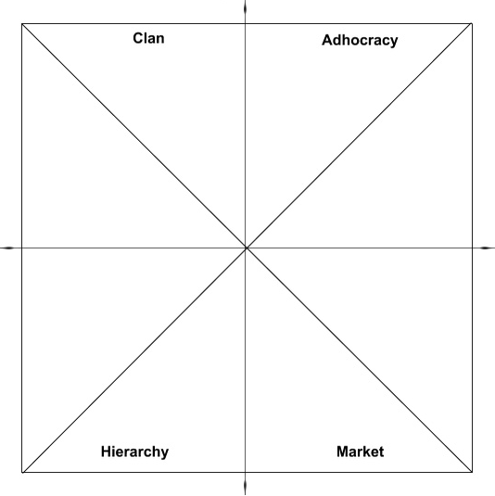
How this Course Helps You Become a Balanced Leader
Ministry & Relational Competencies
• Cross-Cultural Management & Ministry
• Christian Community Development
• Leadership in Diverse Communities
• Urban Youth Ministry
• Vocation, Calling & Purpose of Work
• Nonprofit Human Resources
• Organizational Behavior
• Technology, Life Balance & Addiction
Innovation Competencies
• Social Entrepreneurship
• Small Business Management
Ministry Skills
Entrepreneurial Skills
Human Resources Support Function
Human Resources Policy Function
Introduction
& Capstone
Courses
Operations
Skills
Business Skills
Operations & Governance Competencies
• Nonprofit Startup & Board Development
• Nonprofit Financial Accounting
• Project Management
Business & Funding Competencies
• Marketing
• Grant Writing
• Nonprofit Fundraising
• Nonprofit Managerial Accounting

Slide 3
Our Constructionist Approach to Learning
Learn by Building (major project)
Reading
Tools & Templates
Discussions
Videos

Slide 4
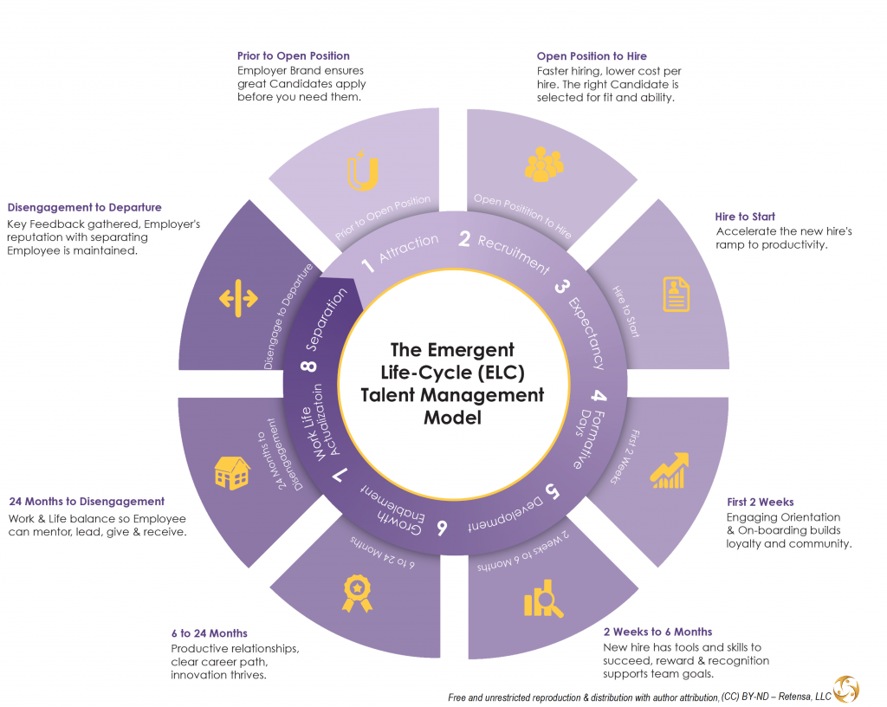
Organization of Course: Stages of Employee Life Cycle

Slide 5
Course Outcomes
After completing this course, you should be able to:
Outline an organization’s hiring process.
Develop key documents needed in hiring including job postings, job descriptions and interview script and scoring.
Develop a plan to onboard and train new employees.
Write a sample performance evaluation of an employee using best practices.
Apply best practices of managing difficult staff members and develop a corrective action plan and separation plan for a sample employee.
Evaluate an employee manual to ensure that it follows best practices and addresses key legal issues.
Review a volunteer program to identify processes and best practices.
Create a nonprofit manager’s employee supervision toolkit manual synthesizing practical human resources tools.
Notes:
What makes this course unique?
Target audience. Average age: 40
Gender: 50% male, 50% female
Race: 60% White, 30% Black, 10% Latino/a
Country: 85% US, 15% international
80% serving under-resourced communities or in under-resourced organizations
2.

Slide 6
Course Outline by Week
Week One: Introduction to HR & and the Hiring Process
Week Two: Hiring Staff: Recruitment, Job Descriptions and Interviewing
Week Three: Employee Onboarding, Compensation, Benefits and Care
Week Four: Employee Development, Training and Performance Management
Week Five: Employee Interactions, Addressing Employee Problems and Separation
Week Six Human Resource Best Practices, Policies and Legal Issues
Week Seven: Managing Volunteers & Interns
Week Eight: Final Project
Plan to spend an average of 17 hours per week on every three-credit course.

Slide 7
Educational Philosophy & Design of This Course
Create
Understand
Remember
Evaluate
Apply
Analyze
8. Final Project: Manager’s HR Toolkit
7. Evaluate Volunteer Program
6. Evaluate HR Best Practices & Employee Manual
5. Corrective Action & Separation
4. Performance Evaluation
3. Onboarding Toolkit
2. Hiring Toolkit
Live Meetings
Forums
Take notes
Reinforce Content Retention with Reading & Videos
https://en.wikipedia.org/wiki/Bloom%27s_taxonomy

Slide 8
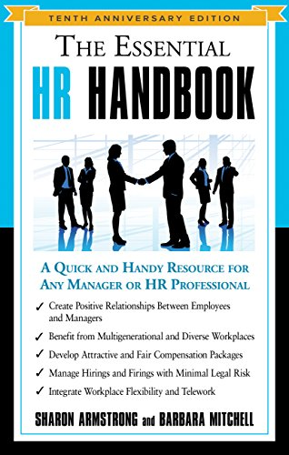
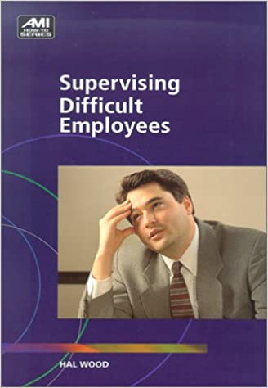
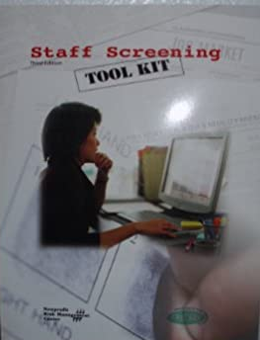
Required Reading for Course
Primary Book
Free PDF’s

Slide 9
What Makes this Course Unique
Target Audience for this course
  New manager, mid-level manager or someone aspiring to be a manager in a nonprofit organization or ministry
  Assumes that most students will not have executive authority over organization’s HR policies
  General HR principles will also apply to business careers
What makes this course unique relative to other HR courses?
  Practical relevance & tools
  Focus on nonprofit organizations
  Specific application to Christian nonprofits and ministries

Slide 10
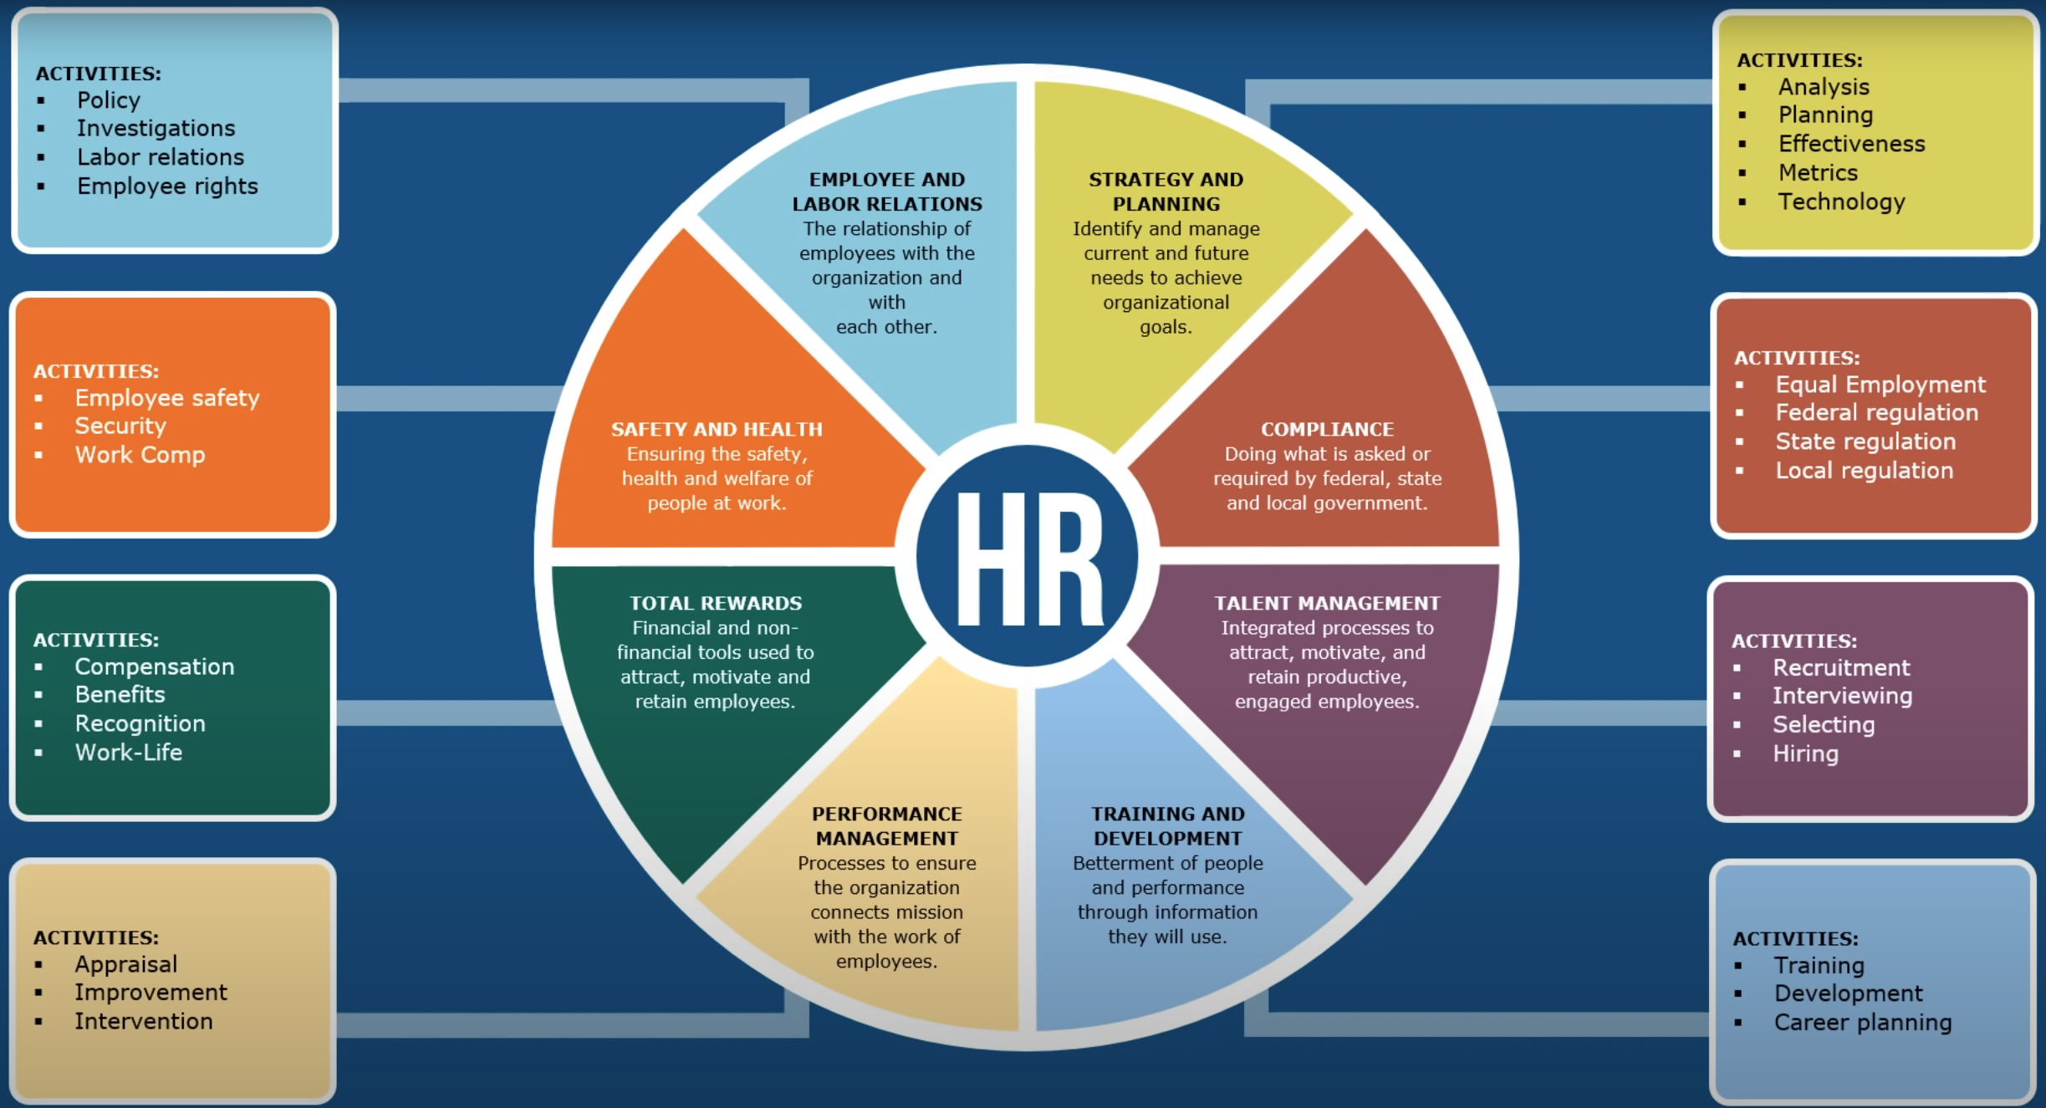
Focus of This Course: Human Resources for Nonprofit Managers
5
5
5
4
5
1
2
3
Image source: https://www.youtube.com/watch?v=A2HFusWQIeE

Slide 11
Final Project Rubric
First Priority (70%): Practical Usefulness and Value to Organization
  From the perspective of an organizational Executive Director or board member, how effective would this project be? If the student is building on third party templates, how much value has the student added by customizing or extending the templates for the organization?
Second Priority (20%): Mastery of Course Concepts
  How well does the document reflect that the student has mastery of the concepts involved in this course?
Third Priority (10%): Professionalism of Writing
  Does the document reflect the professionalism and accuracy expected in similar organizations in its writing and presentation of materials?

Slide 12
Review Final Project Template

Slide 13
Lesson 1b: The Role and Ministry of Human Resources & Hiring Process Overview
Angie Criner
Owner/Consultant
Career Cross Training
careercrosstraining@gmail.com
Nonprofit Human Resources

Slide 14
About Angie Criner & Career Cross Training
Angie Criner is the owner and founder of Career Cross Training, LLC and has specialized in Human Resources consultation and training for 20 years, focused primarily on working with 501 (c)3 charitable religious organizations. She has assisted 70+ ministries establish and strengthen their HR strategy and infrastructure, exercise their rights, protect and advance their mission, and bring compliance and alignment to human resources within ministry. She loves working with organizations to set up HR systems and strategies so that employees can focus on carrying out their core functions and purpose.
Angie is a member of the Society of Human Resource Management with a PHR certification and holds a Bachelor of Arts degree in Communication Studies from Azusa Pacific University. She is currently pursuing her MBA in Nonprofit Management.
Angie resides in Centennial, Colorado with her husband and kids and spends as much time outside adventuring as possible. For more information, Angie can be reached at careercrosstraining@gmail.com or 719.201.6392.

Slide 15
The Ministry of HR
Employees are our most costly and valuable resource
Responsibility and Privilege
Employee realities – making a difference vs. making a living
You will spend time in this area
Boils down to…
  Stewardship
  Protection
  Accountability

Slide 16
A. Stewardship Role of Human Resources
1. Time, Talent, and Resources Matthew 25: 14-29, Romans 12:4-6a
2. Accountable for non-use or mismanagement
We have a stewardship responsibility with what the Lord has entrusted to us. HR, done right should reflect this. It has direct and significant bearing on all aspects of ministry and organizational function.

Slide 17

B. Protection Role of Human Resources
We have a charge from the Lord, as leaders, to be responsible for those He has entrusted to us. I Peter 5:2,3
An organization that knows and pursues legal compliance and “best practices” and is intentional about employee relations creates protection for the ministry and the employees.

Slide 18
C. HR’s Role in Alignment & Integrity
Should maintain/uphold organization’s strategic vision
Should fit together and not be in conflict
Supports and is aligned with core values
Top, down; inside, out
Should facilitate participation within ministry
Increasingly equip employees to deepen engagement and contribution
Creates trust and builds credibility

Slide 19
Human Resources from a Christian Perspective
Organization’s Formation and Purpose as foundation
Intentionally and Clearly Communicate
Respect and Dignity
Personalized
Establish realistic expectations

Slide 20
Risk Management Landmines
Negligent Hiring
Negligent Supervision
Negligent Retention
Wrongful Discharge
Harassment & Discrimination
Safety
Security of Information

Slide 21
Define Hiring Process
There should be a process that defines how hiring happens
  Post/Advertise – Where and How
    - Advertise so that the wrong people screen themselves out
  Send Application and Questionnaire to Potential Applicants
  - Screen Application, Resume, and Questionnaire together
3. Schedule first and subsequent interviews accordingly
  - Ask the right questions
  - Non-Verbal considerations

Slide 22
Define Hiring Process (cont.)
4. Once down to final applicants, conduct due diligence
  - Check references, compare notes, review
  - Candidate Evaluation form
5. Make a decision, draft offer letter, make offer to applicant and give all relevant docs
- Statement of Faith, Quals for Employment, Job Description
- Conduct background checks

Slide 23
Define Hiring Process (cont)
6. Spend time On-Boarding
- Orientation Checklist
- Comprehensive – all aspects of the organization
- Not “one and done”
7. Build in Evaluation/Feedback
8. If you see red flags during Introductory Period, don’t ignore
9. Listen and Invest

Slide 24
Sample Hiring Process Part 1
Open Position
Complete Job Requisition Form and submit to CEO for completion and approval
HR will post opening and direct applicants to ABC website for more information. Application is available on ABC website.
To Apply for Employment
Individuals may apply through ABC website or Indeed or other.
Initial Screening
HR will screen applicant materials. For those who only submit Resume and/or Application, HR will follow up with those who have potential and send them Statement of Faith and Qualifications for Employment, and Questionnaire for review. If applicant still interested, will complete Questionnaire and return to HR.
All application materials received throughout ABC should be forwarded to HR.
HR will send confirmation of posted position
Applicants will email applicant documents to HR
HR will review all materials to ensure applicant meets minimum employment requirements (faith alignment) and job qualifications and will forward those to appropriate Manager/Director, etc.

Slide 25
Sample Hiring Process Part 2
First Interview
HR or Manager/Director will contact candidates to set up interview times.
Post - Interview
Each interviewer should complete a Candidate Evaluation Form for each interviewee.
Additional Interviews
Set up additional interviews as needed. Note on Job Requisition Form whether CEO/C-Level indicated that they would like to meet.
Pre-define what core questions will be asked (HR + Manager/Director). Ask core questions of all candidates.
Review Candidate Evaluation Forms and discuss candidates with other interviewers.
Determine which candidates remain of interest. HR will notify candidates no longer under consideration.
Check references and verify work history for candidates who remain in process. HR to verify employment and references may be checked either by HR or Director.
Determine if another interview is desired or needed. (Job Requestion Form or choice)
If Manager level or higher, Directors plus C-level must interview. Depending on position, may also wish or need to involve employees within and outside of department.
Coordinate next interviews with selected candidates and appropriate staff.
IF ANOTHER INTERVIEW IS NOT NEEDED
- Decide which candidate you'd like to offer the job
- Get approval from CEO or C-Level for conditional offer, including amount of compensation to be offered.

Slide 26
Sample Hiring Process Part 3. Making an Offer
Call the candidate and make a verbal conditional offer of employment.
HR sends candidate a written conditional offer of employment letter, Statement of Faith & Qualifications for Employment signature page, job description, and benefit summary.
Candidate comes in to meet with HR and returns required signed documents and signs an authorization to conduct background investigations and other required screenings.
Once candidate clears background investigations, HR completes New Hire Paperwork and employee begins work.
If individual does not pass background, HR will notify.

Slide 27

Lesson 2: Hiring Staff: Recruitment, Job Descriptions and Interviewing
Angie Criner
Owner/Consultant
Career Cross Training
careercrosstraining@gmail.com
Nonprofit Human Resources
Notes:
Wholistic
Western reductionist mentality that breaks things apart that were never apart in the Bible

Slide 28
Why Does Hiring Well Matter?
Stewardship – there is a direct correlation between how well an organization hires and stewards human resources and the effectiveness of the organization to fulfill its’ purpose.
Culture – People are the greatest influence and contributor to culture.
Cost – Employee turnover is immensely expensive, monetarily and otherwise, to an organization. Hiring and onboarding well will save an organization time and money later on.
Generally and spiritually mature people, appropriate to the position

Slide 29

Common Hiring Mistakes
Hiring based on the individual and not the organization
Hiring in desperation, under pressure
No reference or background checking
Inconsistent practices and procedures
No or insufficient job description
No or inadequate training/onboarding
No or inadequate evaluations/feedback

Slide 30

Jim Collins: Good to Great Advice
Get the right people on the bus
  Alignment with organization’s mission & values
Get the right people in the right seats on the bus
  Alignment of skills and personality type with position (competence)

Slide 31
Adapting Jim Collins’ Advice in Under-Resourced Organizations
What if you cannot afford to pay the right people for the right position?
  Get the right people on the bus
    Misalignment with organization’s mission & values creates mission drift
  Get the right people in the right seats on the bus
    Misalignment of skills and personality type with position will result in staff who are incompetent for their positions and will create conflict or will leave duties/portions of the job undone
Potential Solutions
  Be willing to live with significant levels of dysfunction
  Invest more in recruiting
  Invest more in training – time and money
  Do less to be able to pay people more

Slide 32
Recruitment Strategy Funnel
Post on many job boards, post to website, email blast requesting referrals
Final Interviews & Reference Checks
(3)
Applications
with automated screening questions
(200)
Applicants Sent Second Customized Questionnaire or Screening Interview
(20)
Applications to
Manually Review & Initial Score
(10)
Complete Program
(3)
Applicants Interviewed & Scored
(10)

Slide 33
Job Posting Websites for Nonprofits & Ministries
Organization’s Website
Indeed
Craig’s List
LinkedIn
Citygate Network, Inc.
Local or Regional Non-Profit Consortium
Non-Profit Center for Excellence
Facebook
Area colleges, universities, tech/trade schools, seminaries
Partner agencies and churches
Volunteer E-Blast
Center for Non-Profit Excellence
Trending Apps: https://www.topresume.com/career-advice/job-search-apps
Ministryjobs.com
Christianjobs.net

Slide 34
Hire Slow, Fire Fast
A. Spend the time in hiring the right people. Take the time to define what you need and want in advance of hiring.
Position requirements. Degree, licensure, prior experience, valid driver’s license, etc.
Job Description. Functions and responsibilities of the job and how it fits within the organization.
Character Traits. Personable, ethical, diligent, collaborative, teachable. Think through what is not only beneficial or needed related to being able to do the job but also to function well with department members and culture.
For religious organizations: Faith Alignment - Be unapologetic about who you are and what you need – as an organization and for the position.
Advertise so that the wrong people screen themselves out.

Slide 35
Posting & Advertising
If you are a faith/religious organization, you can advertise your job openings in any venue and be clear about the required same faith alignment.
Sample language – job posting
“Able to write a high number of high quality and persuasive grant applications and attain funding to substantially increase giving and support ministry operations. The right candidate will be professional, ethical, and able to maintain confidentiality. Must be able to effectively share the needs and the life-changing stories with those who want and can participate in the fiscal stability and growth of the ministry. Must be a committed Christ-follower, team player, possess a stewardship mindset, assertive and effective in fundraising and relationship management.”
“The RA position ensures the safety and well-being of our guests and residents and is one of relational ministry, interacting with our shelter guests and program residents to offer biblical encouragement, hope, support and accountability. The right candidate will have a heart for ministry with those who currently struggle with brokenness, and the ability to compassionately but firmly come alongside, offering hope and life transformation through Jesus Christ. Must be a grounded Christian, team player, have a teachable spirit, have good organizational skills, be computer literate and good written and interpersonal communication skills.”

Slide 36
Hire Slow = Intentional, Right
Establish and follow a process
  Collect application and questionnaire and review against what is needed based on job description.
  Conduct Initial Interview by phone to confirm fundamental requirements
  Subsequent Interviews
    Ask the right questions – Pre-define some that will be asked of all applicants
    Train and Coach Managers
    Look for fit in both heart & head

Slide 37
Get the Necessary Pieces
General Application Form
  If you are a religious/faith employer, do not use one from the internet or purchased “off the shelf”
  Include information and questions on your application form that are relevant to your workplace.
Questionnaire
  Specific to the position and alignment-related with ministry
Job Description
  Accurate and up to date
  Essential Duties & Responsibilities
  Skills & Qualifications
  Working Conditions & Physical Factors
  Education, Experience, licensure or other credentials

Slide 38
Legal Considerations
It is very important to be careful to follow legal requirements at every stage in the hiring process
  Know what you can and can’t ask on a job application
    NO: social security number, date of birth, arrests, protected status – Federal & State
    Ban the Box
  Know what you can and can’t ask in an interview
    Check federal and state limitations
    Often can’t ask about marital status, place of birth, how many sick days taken at last job
  Know what you can and can’t ask for before making a conditional offer of employment and securing authorization
    No background checks, drug tests, or third-party consumer reports
    You can ask for a motor vehicle record from the past 90 days provided that is primary and essential to the job
See lesson 6 for more details

Slide 39
Common Key Points for Religious Employers
  A. Understand your Religious Freedoms and Exercise
    Organizational Religious Exemption – Civil Rights Title VII
    BFOQ – Bona Fide Occupational Qualification. Position related.
    Ministerial Exception – Recently expanded by Supreme Court ruling. Individually applied.
    Typically Not EEOC

Slide 40
Common Key Points for Religious Employers
It should be CLEAR that you are a faith-organization that is committed to fulfilling the purpose of the organization.
  Post/Advertise with clear religious statement and requirements
  Ask about testimony/personal faith within Application Form
  Additional Narrative Response Questions either as part of application or in addition to
  Interview questions should include faith-related questions and those that aim to measure level of faith maturity.
  At least one reference should be religious
  Religious duties, expectations, and requirements should be stated on job description

Slide 41
Common Key Points for Religious Employers
Don’t overstep your rights. If you have the right to discriminate/prefer in hiring, related to religion, it doesn’t automatically permit latitudes in other protected statuses.
Use it or you could lose it. If utilizing an Organizational Religious Exemption then you must be consistent across the board. If you say that all employees need to ascribe to your faith because that is essential to effectively operate the organization, then you can’t begin to pick and choose when an employee needs to be of the same faith or not.

Slide 42

Application Essentials
Customized to your organization – Who You Are. Use your logo and Mission Statement or tagline.
Education, Certifications, Licensure, Training
Work History
Questions related to organizational alignment: “Please share your testimony.” “Please share with us why you want to work for ABC Non-Profit.” “Is there anything else that you think is important for us to know?”
Don’t
ask for sensitive information on the first page – criminal convictions, etc.
ask for information you are not permitted to ask: age, ss#, origin of birth, other protected statuses
say that you are an EEO employer if you are not
The Application is a legal document that belongs to the employer. By signing the Application form, the applicant gives the employer permission to verify the information provided on the Application form.
The Application is used, along with other provided information by the applicant, to confirm consistency of information and identify gaps or areas of uncertainty.

Slide 43
Key Components of Job Descriptions
Write for the job, not the individual
Purpose/Summary – Organization and Position-specific
Signed & Dated
Classification (exempt or non-exempt)
Accountability – Reports To:
Required Duties & Responsibilities
Skills & Qualifications (Personal Characteristics)
Physical Factors/Working Conditions (ADA compliance)
Education & Experience
Essential Part of Ministry – may include BFOQ or ministerial exception

Slide 44

Interviews
A. Define who will be involved
  Make sure all involved have been trained
B. Define what will be asked
  Confirm faith alignment
  Know what can and can’t be asked
  Pre-define some questions that will be asked of all applicants that address core functions and requirements of the job
C. Determine
  Fit
  Ability/skills/experience
  Interest
D. Solve gaps or conflicting information

Slide 45
Sample Hiring Table
POSITION | INITIAL INTERVIEW | 2ND INTERVIEW | 3RD INTERVIEW
Director | Executive Director HR | Executive Director HR | Optional – Meet with other Directors
Manager | Director HR | Executive Director | Optional – Meet with other Managers
Supervisor | HR | Mgr/Director | Executive Director
Coordinator | Superv/Mgr HR | Department Head HR | Optional - Executive Director
Associate/Entry | Department Head HR | Superv/Mgr | Optional - Executive Director
Temporary | HR Superv/Mgr | Superv/Mgr HR | N/A

Slide 46

Expectations
Too often an unsuccessful hire is the result of unmet expectations. This can happen on the part of the employee and the employer. Don’t assume that because a candidate wants to work in ministry that they are on the same page as you.

Slide 47
What Defines FIT?
Theological Alignment
  Statement of Faith
  Christian Ministry
  Romans 12
Philosophy of Ministry
  This may vary depending on the position that you are filling
Character
  What are the core values of your organization?
  What character traits must you have?...do you prefer?

Slide 48
What Defines FIT?
Competence
  CAN this applicant do the job: what are the required duties?
  What does the position require? People, Task, Process orientation
Culture
  Definition: The overall attitude, beliefs, expectations, and habits of a workplace
  A set of collective beliefs and values that influence behavior

Slide 49
Reference Checking
REFERENCE CHECKING
  Ideally the same person should do this
  Difference between employment verification & reference
  “Good Faith”
BACKGROUND INVESTIGATIONS
  Pre-determine what investigations will be done for various positions
  Be consistent within job categories
  Know when the investigation constitutes a consumer report

Slide 50
Background Investigations and Clearances
An employer is restricted on when certain information about an applicant may be requested.
A conditional offer of employment must be made BEFORE conducting a drug test, criminal background check, nearly any third-party consumer report, or a fingerprint clearance.
An authorization signature must be obtained from the individual for to conduct background checks. This must be a separate document and cannot and is not covered by signing an application form or offer letter.

Slide 51
Employment Screenings Per Position
Post Offer of
Employment has
been made.
POSITION | DRUG TEST | BACKGROUND | MVR | FINGERPRINT | EDUCATION RELATED | OTHER
Maintenance Worker | X | X | Maybe | X
Resident Assistant | X | X |  | X
Bookkeeper | X | X
Case Manager | X | X | X | X | X
Shelter Manager | X | X |  | X
HR Assistant | X | X
Grant Writer | X | X
Data Entry Specialist | X | X
VP of Programs | X | X | X | X | X
Volunteer Coordinator | X | X | X | X
Warehouse Associate | X | X
IT Helpdesk | X | X | X | X
Donations Driver | X | X | X
Food Services Associate | X | X

Slide 52
Making an Offer
Put it in writing and Include:
  Position
  Classification
  PT/FT/Seasonal
  Start Date
  Rate of Pay
  At Will
Contingent Upon
  Right to Work in the US
  Background Checks, Child Clearances, Drug Tests, other

Slide 53
Lesson 3: Employee Onboarding, Compensation, Benefits and Care
Angie Criner
Owner/Consultant
Career Cross Training
careercrosstraining@gmail.com
Nonprofit Human Resources

Slide 54
Compensation & Benefits – Non-Profit Uniqueness
Most people who pursue employment with a non-profit and/or ministry don’t do so for the big money. They are looking for care and “benefits” of another kind.
Culture
Meaning
Fulfillment
Contribution
Being part of something bigger than them or something long-lasting
Employees still have to make a wage sufficient to care and provide for self and family or they can’t afford to work for the non-profit.

Slide 55
Compensation
Total compensation still needs to be “fair”
Work/Life Balance
Competitive with respect to Non-Profit sector
Market cost and demand
There should be established compensation ranges for all positions
Pull information from comparable markets/organizations
Educational attainment, licensure, certifications
Direct and transferable experience
Starting comp is typically at the 20th – 65th percentile of range

Slide 56
Compensation
Communication:
Publish compensation ranges and how individuals can be placed higher within the range.
Let employees know how and when they can increase their wage.

Slide 57
Mandated & Fringe Benefits
Mandated - Federal
Health Care. If employer has 50+ FTEs must provide health care insurance to ees who work 30+ hours per week and the health care must be in place by day 90 of employment.
Family Medical Leave (FMLA). Applies to employer who has 50+ ees by headcount for 20+ weeks of current or prior year. EE is eligible if has worked for employer for 12 months and worked 1250+ hours in past 12 months. Up to 12 weeks unpaid, benefit-continued, job-protected leave for eligible reasons related to ee’s health or that of an immediate family member.

Slide 58
Common and Trending State Mandated Benefits
Check your state.
Paid Sick Leave
Paid Family Leave
Disability Leave
Parental Leave
Unemployment

Slide 59
Fringe/Non-Mandated Benefits
Dental Spiritual Support & Encouragement
Vision On-Going Education Assistance
Retirement Spiritual Retreat
Life Insurance Social Outings/Opportunities
Wellness – gym memberships Paid Volunteer Time
Vacation/PTO EAP
Holidays Retail Discounts
Personal Days Free Meals/Snacks
Flexibility
Reasonable weekly schedule

Slide 60
Documents Required to Hire
Federal Tax Withholding – IRS form W-4 (new form in effect as of 2020)
State or Local Tax Withholding
Verification to legally work in the USA – INS form I-9

Slide 61
Personnel Files
  Two Per Employee
  1. Employment
  2. Medical
  I-9 forms should be separate, can’t be in personnel file
  Centralized and Secure
  Confidential
  Access Laws Vary
  Official vs. Unofficial Files

Slide 62
Effective Onboarding & Orientation
Move your Introductory Period to Six Months
Use a Checklist
Orientation is more transactional – practical provision/access of needed information and resources to be successful
Onboarding is more about assimilation – equipping beyond tangible resources to be successful.
Onboarding should be comprehensive including all aspects of ministry or organization.
Time spent up front, in onboarding and orientation should save you time down the road.

Slide 63
Components in New Employee Orientation
For Orientation, think through the needed information or things that are necessary to get a new employee started on the right foot.
Use a Checklist
Paperwork Completion – New Hire, Payroll/Tax Related, etc.
Staff Directory: name, title & extension, work location
Keys and Supplies
Time Keeping and Payroll
Workspace set up
Schedule
Location of restrooms

Slide 64
Onboarding
For Onboarding think through engagement of the new employee. What is needed to have the new employee feel valued, prepared, informed, equipped?
Onboarding is your best opportunity to model your Mission Statement and Core Values.
Use evaluations to set expectations, facilitate engagement, and measure progress and attainment at pre-determined stages. What do you need the new employee to know, demonstrate, learn by:
  Day 30-45
  Day 90
  Day 120

Slide 65
Onboarding
Provide the onboarding/introductory evaluations to the employee up front.
Schedule time to review each evaluation and make it a two-way feedback opportunity.
Helps to understand and manage expectations
Provides you with insight to your new employee

Slide 66
Onboarding
History
Strategic Plans
Mission, Vision, Values
Description of Programs & Services
Time spent in all areas of organization
Trainings
Role, Department, Organizational contribution and connection
Build in intentional time for feedback from new employee daily/weekly

Slide 67
Lesson 3b: Developing Healthy Employee Interactions
Angie Criner
Owner/Consultant
Career Cross Training
careercrosstraining@gmail.com
Nonprofit Human Resources

Slide 68
Relational Competence
Trust
Environment/Culture & Relationships
Accountability

Slide 69
The Importance of Employee Relations
Often, the HR function is more of a “policing” entity. If an employee gets called to HR, it is akin to “going to the woodshed”.
In non-profits and certainly in religious non-profits, the employee relations component takes a far more central and primary role.
Whether in HR or in a management role, success/effectiveness has direct correlation to employee relations.
We don’t always have a choice about WHAT needs to be done but we always have choice about HOW we do it. The HOW is key. The HOW should line up with core values, desired culture, and individual value.

Slide 70
The Importance of Employee Relations
Relationships play a critical part within religious non-profits and are a significant contributor to the culture.
If management takes the time to establish authentic and trusting relationships with employees up front, it creates a better opportunity
to address challenging circumstances when they arise
to have a more favorable outcome
Safe and Healthy relationships, Safe and Healthy environment/culture

Slide 71
Why Interpersonal Competence Matters
“Without interpersonal competence or a “psychologically safe” environment, the organization is a breeding ground for mistrust, intergroup conflict, and rigidity which leads to a decrease in organizational success and problem solving.”
Thrall, McNicol, McElrath, Ascent of a Leader
“Problems in organizations are often more about people’s safety than about people talking to one another. Communication happens naturally when you make things safe. Trust develops through safety and increases the likelihood of mutual understanding.”
Ken Blanchard, Managing by Values

Slide 72
Reality Check
We all make mistakes
We have a limited frame of reference
We can’t do it all on our own
Our way is not always the right or only way
We don’t see ourselves or others accurately or fully

Slide 73
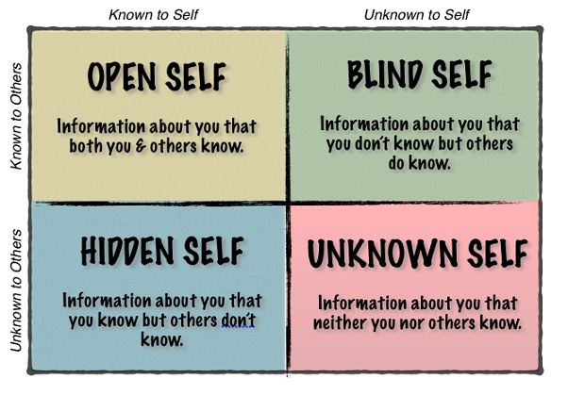
The Johari Window
Image source: https://www.successfulculture.com/build-more-self-awareness-stronger-culture-using-johari-window/

Slide 74

Relational Competence
TRUST
Authenticity
Vulnerability

Slide 75



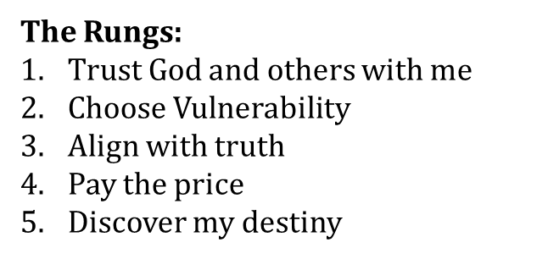
The Character Ladder*
*The Ascent of a Leader by Thrall, McNicol & McElrath

Slide 76
Employee Interactions
ENGAGE
COACH
LISTEN
GIVE FEEDBACK/CORRECTION
FOLLOW UP
ENTRUST

Slide 77
TO
FOR
WITH
DON’T

Slide 78
Lesson 4a: Employee Development & Training
Dr. Andrew Sears
President
City Vision University
www.cityvision.edu
Nonprofit Human Resources

Slide 79
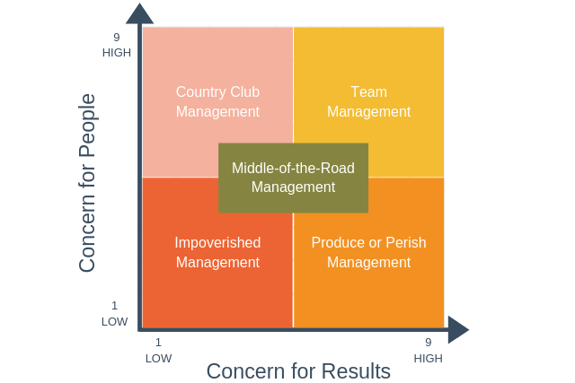
Balancing Concern for People and Results
Goal for effective
management
Source: Blake and Mouton Managerial Grid https://expertprogrammanagement.com/2019/05/blake-mouton-grid/

Slide 80
Spiritual Perspective on Staff Development
Are you burning out employees for the sake of clients?
  Co-dependent model (overly client centered)
Are your employees thriving, but distant from clients who are suffering?
  Overly staff-centered model
Are you ministering to stakeholders at all levels to promote their growth and well-being?
  Balanced Model
How are you investing in your staff?
Are you not 100% legally compliant because of lack of training?

Slide 81
Mechanisms to Support Staff Development
Supervision and mentoring
Mentoring & community
Professional development plans
In-house training & spiritual development
Education Benefits

Slide 82
Types of Educational Employee Benefits
Provide some type of educational benefit (92%)
Tuition assistance/reimbursement (63%)
In-house training seminars (61%)
Attendance at educational conferences (51%)
Continuing education courses (50%)
Coverage for licensing courses and exams (44%)
Personal development courses (35%)
529 college savings plans (10%)
Student loan repayment assistance (4%)
Source: https://blog.ifebp.org/index.php/education-benefits-student-loan-repayment
Notes:
loan repayment assistance benefit. Two percent are in the process of implementing a program and almost one quarter (23 percent) are considering implementing a program in the future—evidence that this is a growing benefit on the radar for many organizations.

Slide 83

City Vision
Institute:
Free Training
Site for Staff,
Participants &
Volunteers

Slide 84


Slide 85
Tuition Reimbursement Programs
How long has tuition reimbursement program existed
  57 percent of organizations have had tuition reimbursement programs in place for between six and 20 years,
  27 percent have had programs in place for 21 years or more.
Reimbursement policies
  87% reimburse after the end of study if employees meet certain requirements
  The most popular reimbursement amount to employees is $5,000-$5,999.
  If an employee leaves the organization within a year after obtaining their reimbursed education, more than half of employers (54 percent) require payback.
Only 1 to 5 percent of employees use of tuition reimbursement

Slide 86
Benefits to Employers of Tuition Reimbursement Programs
Employee Retention: Organizations with tuition assistance report an increase of employee applicants of 20%, increased retention of 10-40% with a 21% increase in promotions for participants and an RoI of 129%.
Fundraising: Tuition assistance creates new opportunities to fundraise toward an "education fund" to fund scholarships for both staff and program participants.
Values Alignment: For faith-based organizations, tuition assistance with organizations with shared values, like City Vision, can help ministries and nonprofits promote values-aligned employees from within.

Slide 87
Tuition Reimbursement Policies & Procedures Best Practices
Define which employees are eligible for tuition reimbursement
Consider whether to make having a passing grade (or a B) on a course a condition of eligibility for reimbursement
Provide a process or form to require approval
Determine what will happen if an employee leaves early

Slide 88
Ensuring Educational Benefits are Tax Deductible
Educational benefits are limited to $5,250/year unless required for job
The plan cannot favor highly paid employees
You must give reasonable notice of the program to eligible employees
Employees can't receive cash or other benefits instead of education assistance
The educational benefit must relate to the employer's business
Sources: Deducting Educational Expenses, IRS 2019 Publication 970, Designing Educational Assistance Programs

Slide 89
City Vision’s Educational Employee Benefit Program
For Any nonprofit organization that has a tuition reimbursement program for its employees and lists City Vision as a recommended partner.
City Vision will provide a scholarship to your employees so tuition will only cost $500/course or $5,000/year for undergraduate and graduate programs (for organizations referring 2+ students annually).
City Vision provides Sample Templates for Tuition Reimbursement Policy, Procedures & Forms

Slide 90
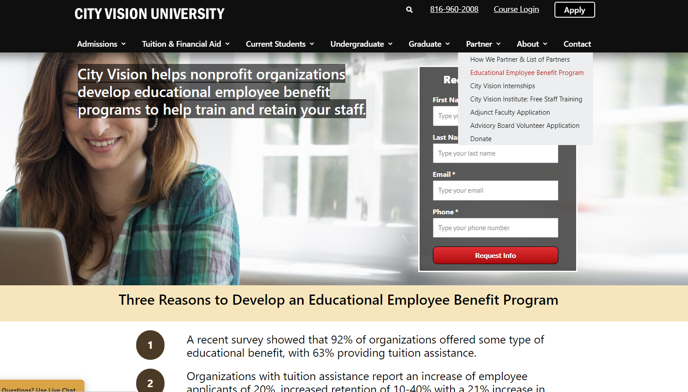

Slide 91

Examples of Organizations with Tuition Reimbursement
91
01
33+ Students with City Vision
Providing one faculty member
"The partnership with City Vision has been one of the most important factors to equip our team to minister to the needs of the poor. Without this partnership, we wouldn’t be nearly as effective serving our most vulnerable neighbors.“
- Vann Ellison, Executive Director, St. Matthew’s House
02
City Vision Student, Michelle Porter
Founded 2 rescue missions
20+ Student & Interns

Slide 92
Lesson 4b: Employee Performance Management
Angie Criner
Owner/Consultant
Career Cross Training
careercrosstraining@gmail.com
Nonprofit Human Resources

Slide 93
Performance Appraisals & Evaluations
Formal Performance Appraisals can be cumbersome.
Historically, once per year
Tied to money so breeds a “performance” behavior
Person conducting appraisal often overwhelmed to get them done
Importance of Performance Appraisals/Evaluations:
Documentation
Clarity
Career Path
Engagement

Slide 94
Performance Management
Especially in a ministry or other non-profit organization, effective performance management has to include and prioritize
Mission Statement
Core Values
Culture
Behavior should support and reinforce

Slide 95
Performance Eval – Values Alignment
Samples of Values Alignment within Performance Evaluation – Define what the value looks like.
FOSTERS TRUST AND TEAMWORK
Maintains confidentiality
Openly communicates, is edifying and appropriate
Honors established leadership
Upholds and adheres to ABC policies and standards
Team Player – is supportive, cooperative, and collaborative
Comments:

Slide 96
Notes on Employee Feedback
Establishing feedback as a normal aspect within the culture will facilitate more authentic and beneficial related conversations and outcomes
Information has to be:
  Specific/Relevant
  Timely
  Usable
Schedule for frequency and solicit employee feedback
Reinforce the “why” more than the “what”

Slide 97
Alternative to (only) Annual Performance Eval
1. Determine when annual Performance Appraisal will be done
Specific time of year for all
Anniversary date
2. Incorporate Self-Eval component
3. Set Goal Setting six months from Performance Appraisal
Individual Employee
Departmental

Slide 98
Alternative to (only) Annual Performance Eval
Set monthly meetings or more frequent meetings with employee
Take notes and file them
How is employee doing within their job?
Write down what employee needs to do, has done/accomplished, and is to focus on before next meeting.
Get input and feedback from employee
Set monthly departmental meetings
Attached to goal setting
Note progress, revision, assignments

Slide 99
Alternative to (only) Annual Performance Eval
When it is time for the Annual Performance Eval
Pull individual employee notes from meetings
Pull departmental notes from meetings
You will have a more realistic picture of how the employee has done over the past year.
This approach facilitates open and regular feedback, thus minimizing surprises.
This approach also builds team – collaboration, accountability, problem-solving

Slide 100
Performance Eval – Action Plan

Slide 101
Performance Eval - Action Plan
Important to understand the importance or need for Goal/Objective
The Follow up is the biggest challenge….and where things get lost!!
Set up first follow up at time of review with employee

Slide 102
Setting Goals
Goal Setting can be done to:
  Improve an area that is currently functioning below what is needed/required
  Engage/motivate employee towards more
Not all goals should be employee generated
Something that can be supported by ministry
Something ministry affiliated
What does the ministry need?
Investment in employees
SMART – Specific, Measurable, Attainable, Relevant, Time Based

Slide 103
Lesson 5: Addressing Employee Problems and Separation
Angie Criner
Owner/Consultant
Career Cross Training
careercrosstraining@gmail.com
Nonprofit Human Resources

Slide 104
Discipline vs. Punishment
Discipline comes from discipulus, the Latin word for pupil, which also provided the source of the word disciple. (Merriam-Webster)
Discipline connotes learning and assumes valued relationship
Punishment is the penalty you have to pay when you're caught doing something bad. ... The Latin root of punishment and its related verb, punish, is punire, "punish, correct, take vengeance for, or cause pain for some offense.“
for the LORD disciplines the one He loves, as does a father the son in whom he delights. Prov. 3:12

Slide 105
Pillars of Effective Feedback/Correction
Equity
Consistency
Intentionality
Documentation
Follow Up
Follow Through

Slide 106
General Principles Related to Discipline
Misconduct: Employees are DOING SOMETHING they should not be doing
Poor Performance: Employees are NOT DOING something they should be doing.
It is important to ascertain whether the reason for poor performance is due to MIS-FIT.

Slide 107
General Principles Related to Discipline
Employers should have clear expectations and disciplinary standards.
The employee must know the NATURE of the issue/problem.
The employee must know the affect(s) of the issue/problem. The WHY.
The employee must know what he/she must do to CORRECT the issue/problem.
The employee must have a REASONABLE period of time in which to fix the issue/problem.
The employee must understand the CONSEQUENCES of inaction or failure to correct.

Slide 108
In providing feedback, think through…
Is this an issue of character or competence
  Typically it is much easier to correct a competence issue
How is this affecting employee’s performance/productivity and also that of the team/others
Values Alignment
CAN vs WILLING
It may be necessary and beneficial to ask the employee about some of these

Slide 109
Addressing Employee Discipline
1. Whenever possible have conversations and disciplinary actions privately. Don’t confront employees in front of other workers.
2. Gather relevant information and facts. Investigate the situation as thoroughly as possible.
3. Address conduct as specifically as possible and relate it back as appropriate to policy, standard, requirement, etc..
4. Treat with respect. Be truthful and kind. Stay focused on issue and avoid character assassination.
5. Remain calm and objective.

Slide 110
Types of Discipline
Corrective Counseling
Corrective Counseling is making the employee aware of that which is not acceptable and verifying that employee knows/understands the expectation and/or requirement.
Verbal Correction
Doesn’t require employee signature but does require documentation.
Written Correction(s)
Requires employee signature
Suspension
This is the most severe form of discipline, short of dismissal. It is most commonly used when severe violations have occurred, when an investigation needs to happen, and/or a volatile situation may need to be diffused.
With or Without Pay
Written Documentation

Slide 111
Types of Discipline
Performance Improvement Plan
Whenever an employee has been involved in a disciplinary situation, which has not been readily resolved, or when s/he has demonstrated an inability or unwillingness to perform assigned work responsibilities efficiently and according to standards, the supervisor, typically in consultation with HR may place the employee in a Performance Improvement Plan. This status should last for a pre-determined amount of time, typically not to exceed 90 days, and within this time period, the employee must demonstrate a willingness and ability to meet and maintain the conduct and/or work requirements as specified by the supervisor and the organization.
The aforementioned types of discipline do not automatically occur in sequential order.
Important to state that management is able to utilize whatever discipline is believed to be appropriate and best in situation.

Slide 112
Documentation Essentials
DATE
WHO
WHAT
WHEN
WHERE
GET IT TO HR

Slide 113
Documentation Essentials, cont.
Stick to facts, what was observed, reported, etc.
Be concise but thorough
Be timely…do it within 24 hours
If a repeat problem, cite such
Too often people get stuck because they believe that the documentation needs to be “perfect”. While a form can be helpful, it won’t fit every circumstance and the most important thing is to get the relevant information documented in a timely manner.
TIP: If you keep a calendar, make notes within your calendar related to concerns, corrective conversations; time, subject, who, etc.

Slide 114
Documentation Realities
It is a critical requirement of your job.
It is fundamental to accountability.
You are not being “nice” or “gracious” to forego documenting issues.
Without documentation, you have more limited options and potentially incur liability for your organization.

Slide 115
Employment Separation
  Dismissal/Termination of Employment
  If problems have not been corrected and previous discipline indicates that failure to correct will result in dismissal, OR if the infraction warrants dismissal on its own, take the following steps:
Take all related information to Executive in charge to secure/approve decision to dismiss employee from employment.
Work with HR to ensure all documentation is compiled and accurate.
Determine appropriate time and place to dismiss employee.
Arrange to have another management person or HR present.
Plan in advance what you intend to say.

Slide 116
Employment Separation
Dismissal/Termination of Employment – continued
6. Maintain control over the situation. If this is not done employees may feel like they can control or change the outcome.
7. Make the dismissal a statement of fact, not open to negotiation. “We have decided to end our employment relationship.” Communicate reasons for decision and provide supporting facts, documentation.
8. Bring all applicable information: final pay or info, date dismissal is effective, insurance information, etc.
9. Collect all keys, identification badges and other security-sensitive items. Either have employee’s belongings boxed up or arrange for that to happen.
If circumstances warrant, have the employee escorted off premises.

Slide 117
Employment Termination
Considerations – Think Through in Advance of Meeting with Employee
Final Pay – check your state law for when it must be issued and what is included
Severance
“Older Worker” Separation Agreements – 40+ years old
IT and other Notifications
Coverage of responsibilities and related conversations

Slide 118
Separation/Termination
  Use a Checklist
  Type of Separation
    Resignation – employee initiated
    Dismissal – employer initiated
    Retirement
  Effective Date
  Eligible for Rehire
  Able to volunteer
  Provide a reference
  Exit Interview

Slide 119
Employment Separation
Exit Interview
1. Conducted by HR or neutral party
2. Gather Employee Feedback
3. COBRA
4. Collect property/belongings
5. Verify Personal Information
6. Final Pay/Severance
An Exit Interview will not be feasible in all separations

Slide 120
Review Templates

Slide 121
Lesson 6: Human Resource Best Practices, Policies and Legal Issues
Angie Criner
Owner/Consultant
Career Cross Training
careercrosstraining@gmail.com
Nonprofit Human Resources

Slide 122
Key laws that govern employment
  A. FLSA – Fair Labor Standards Act
  B. Civil Rights Title VII – Discrimination – Religious Exemption
  Bona Fide Occupational Qualification (BFOQ)
  Americans With Disabilities Act
  Family Medical Leave Act (FMLA)
  Patient Protected Affordable Heath Care Act (PPACA)
  At-Will Employment
  Knowing the key laws that apply to your organization is critical

Slide 123
Applicability & Interplay of Federal & State Laws
If there are both federal and state laws on a subject, applicability is whichever affords the employee the greatest benefit.
Minimum wage
In absence of state law, federal law applies
Commonly, laws apply based on
Type of employer
Number of employees

Slide 124
Laws Commonly Addressed by State
Meal and Rest Periods
Employee Access to Personnel Records
Is Vacation compensable upon separation
Short-term and Long-term Disability
Unemployment
Jury Duty leave
Equality in employment – protected status
Paid Sick leave
Protected and/or Paid Leaves (in addition to federal)
Marijuana – medical and recreational
Cellular usage while driving

Slide 125
Federal Employment Laws Overview
Employment Law | Applies To | Summary
FLSA Fair Labor Standards Act | All workplaces engaged in interstate commerce | Federal law that defines the 40-hour work-week, covers minimum wage, sets overtime requirements and restricts child labor laws.
FMLA Family and Medical Leave Act | Employers who employ 50+ employees. Count is by headcount. | Federal Law requires employers to give employees up to 12 weeks of unpaid leave during 12-months of time. Employees qualify if they have been employed at same workplace at least 1 year and worked 1,250 hours minimum during the preceding year
Civil Rights Act Title VII | Employers who employ 15+ employees. | Most powerful law prohibiting discrimination in the workplace. Minimum protections granted by federal law: race, color, gender, age, religion, national origin, physical and mental disability, veteran status, genetic information, familial status, pregnancy. Covers all aspects of employment relationship.
PPACA Patient Protected Affordable Care Act | Employers who employ 50+ FTEs. FTE = 30+ hours per week. | Requires eligible employers to provide employees who work 30+ hours per week with health care coverage that is in effect by day 90.

Slide 126
Federal Employment Laws Overview
Employment Law | Applies To | Summary
ADA: Americans With Disabilities Act | Employers who employ 15+ employees, including part-time employees | Prohibits employers from discriminating on the basis of physical or mental disability. Disability may be permanent or temporary. Requires employers to “make reasonable accommodations” for qualified individuals, unless it would cause undue hardship.
Equal Pay Act | All employers who are covered by FLSA | Prohibits employers from paying employees differently based on gender. Same work location, same work, same pay.
ADEA: Age Discrimination in Employment Act | Employers who employ 20+ employees. | Outlaws discrimination in the workplace based on age. Applies to those employees who are at least 40 years old.
Older Workers Benefit Protection Act | All nonunion employees in private industry | Amendment to ADEA. Outlaws discrimination of employee benefit programs and protects older workers from staff cuts. Applies to those employees who are at least 40 years old.

Slide 127
Federal Employment Laws Overview
Employment Law | Applies To | Summary
PDA Pregnancy Discrimination Act | Employers who employ 15+ employees | It is illegal to refuse to hire a pregnant woman based on her pregnancy or related medical condition, to terminate her employment or to compel her to take maternity leave.
OSHA Occupational Safety and Health Act | All business except: Self-employed w/ no employees, farm with only immediate family members, or business such as mining w/ other regulations | Designed to reduce workplace hazards and improve health and safety programs for workers. Requires employers to provide a workplace free of physical dangers and meet specific health and safety standards. Also requires employers to keep detailed records, report workplace accidents within time period, to conduct safety training, and to post federal/state information.
BFOQ Exceptions Bona Fide Occupational Qualification | All employers if there is a legitimate reason. Few actually qualify. | Permitted discrimination based on employer’s legitimate reason to have job qualifications for a particular position that would normally be illegal, typically by violating Title VII. Gender is a more commonly used BFOQ. Religion may also be a BFOQ.

Slide 128
Fair Labor Standards Act - FLSA
The FLSA defines coverage/applicability regarding minimum wage, overtime pay, recordkeeping, and youth employment standards affecting employees in the private sector and in Federal, State, and local governments.
Originally passed in 1938 as part of the “New Deal”.
No Federal exemption exists for Churches or Religious Organizations

Slide 129
Two Ways in Which FLSA Can Apply
1. ENTERPRISE COVERAGE – entity has at least $500,000 of “annual gross volume of sales made or business done” AND has employees engaged in interstate commerce.
Enterprise Coverage excludes: Cash or in-kind donations as part of the $500,000
2. INDIVIDUAL COVERAGE– employee is engaged in interstate commerce or in the production of goods for commerce or that the employee is handling, selling, or otherwise working on goods or materials that have been moved in or produced for commerce by any person.
Individual Coverage includes activities such as:
    Making out-of-state phone calls
    Receiving/Sending interstate mail or electronic communications
    Ordering or receiving goods from an out-of-state supplier; and
    Handling credit card transactions of performing the accounting or bookkeeping for such activities

Slide 130
FLSA: Employee Classification
How employees are classified determines how they are paid (hourly or salaried) and if they are eligible for overtime.
Employee classification is the most common area that is misunderstood and applied incorrectly. The DOL estimates that half of all employees are improperly classified.
It is permissive to classify an employee who meets exempt criteria as non-exempt but it is NOT permissive to classify a non-exempt employee as exempt.
Legally, not KNOWING is not acceptable.
Liability for doing this wrong is significant and being a “ministry” doesn’t afford you protection or exception.

Slide 131
FLSA: Non-Exempt Workers - Hourly
The majority of workers fall into this category.
Non-exempt workers get paid for the time that they work.
Non-exempt ees are required to track and submit their working time and be compensated for all time worked.
Entitled to over-time pay at a rate of 1 ½ times their regular rate for every hour worked over 40 hours within an established workweek.
When calculating overtime hours, only count actual hours worked. Paid leave time (sick, holiday, vacation, etc.) is not calculated for OT.
You may put non-exempt employees on a salary but they are still entitled to over-time for any hours worked over 40 within the workweek.
It is illegal to volunteer to work overtime within same department.

Slide 132
FLSA: Exempt Worker Categories
Exempt workers get paid to get the job done, not for the amount of time spent in doing so.
There are federal definitions of exempt workers. Some states also have definitions.
Executive Exemption
Administrative Exemption
Professional Exemption
  Creative Exemption
Computer Employee Exemption
Outside Sales
Highly Compensated

Slide 133
Three Tests for Exemption
Salary Level – Effective January 1, 2020
  $684 per week/$35,568 annually – Federal, some states vary
  Free and Clear – can’t include room, board etc.
Salary Basis – regularly receives pre-determined amount of compensation, without fluctuation due to quantity or quality.
Job Duties
  Specific to each type of white collar exemption

Slide 134
Exempt Position Type Definitions
Executive: Employees whose primary duty is to manage the business or a recognized department/entity and who customarily and regularly directs the work of two or more employees (equivalent to 80+ hours per week). Also includes authority to hire or fire or make recommendations that carry significant weight regarding employment actions.
Administrative: Employee whose primary activities are performing office or non-manual work on matters of significance relating to the management or business operations of the firm or its customers and which require the exercise of discretion and independent judgment.

Slide 135
Exempt Position Type Definitions
Professional
Employee who primarily performs work requiring advanced knowledge/education and which includes consistent exercise of discretion and independent judgment. The advanced knowledge must be in a field of science or learning acquired in a prolonged course of specialized intellectual instruction.
Academic training is a pre-requisite to enter the profession; best evidence is employee possesses appropriate degree.
Creative professionals perform work requiring invention, imagination, originality and/or talent in a field of artistic endeavor.

Slide 136
Exempt Position Type Definitions
Computer
Analyst or programmer level
Highly Compensated
$107,432+ per year, of which at least $684 is paid weekly
Fulfill at least one of the duties from other white collar exemptions

Slide 137
Common Questions – Wage and Pay Related
Do I have to have all employees record their hours?
Do I have to use a Time Clock?
What about changing time that has been recorded?
What if my employees don’t want to be paid overtime?
Can I have different established work weeks for different employees?
What about comp time?
Same employee two different part-time jobs at same organization

Slide 138
Employment At Will
Employment is “at-will” in all US states other than Montana
At-Will means that either the employer or employee may end the employment relationship with or without cause or notice.
Does not grant an employer a “blank check” to fire an employee.
Some conditions around at-will employment

Slide 139
Patient Protected Affordable Care Act
Defines a full-time employee as someone who works 30+ hours per week
Requires that eligible employees are ENROLLED in health care plan BY day 90
Requires that eligible employees be offered affordable health care for employee + dependents, not including spouse
Premium cost for employee must be “affordable”, which is not to exceed 9.5% of annual household income.
“Affordable” does not apply to cost of dependent premium
ACA only applies to employers with 50+ FTEs.
FTE calculator: https://www.healthcare.gov/shop-calculators-fte/

Slide 140
Civil Rights Act – Title VII
Title VII of the Civil Rights Act of 1964 is a federal law that protects employees against discrimination based on certain specified characteristics. Under Title VII, an employer may not discriminate with regard to any term, condition, or privilege of employment. Areas that may give rise to violations include recruiting, hiring, promoting, transferring, training, disciplining, discharging, assigning work, measuring performance, or providing benefits.
Federal Law:
race, color, religion, sex (including pregnancy, sexual orientation, or gender identity), national origin, age (40 or older), disability and genetic information (including family medical history).
Check your state law for additional protections.

Slide 141
Civil Rights Act – Title VII
Organizational Religious Exemption
Grants an organization, which is formed and filed based on religion, to hire individuals who share same faith beliefs/convictions.
BFOQ
Applies to a position rather than an organization.
Examples: House Parent in Center for Women & Children,
Clothing Designer hiring models, actor to portray Nelson Mandela
Ministerial exception
Recent Supreme Court ruling and expanded definition
Pertains to the inability to bring suit

Slide 142
Civil Rights Act – Title VII
EEOC – Equal Employment Opportunity Commission
Harassment & Discrimination
  Defines
  Training
  Policies
  Action
Non-Retaliation

Slide 143
Employee Handbooks
If you go to court, this goes with you
  You need an employee handbook if you have 3 or more employees
Employee handbooks should
  Reduce risk and liability
  Communicate expectations and standards
  Provide guidance and information for employees
  Facilitate alignment within organization

Slide 144
Employee Handbooks (cont)
Beware of…
  Absolutes
    Avoid using “will”, “always”, “never”
  Outdated, inapplicable, or inaccurate information
    Handbooks need to be reviewed and updated every two years.
    Keep a copy of the Handbook nearby that you can make notations and entries on an on-going basis for incorporation at the next update.
  Assuming employees know
    Training/Informational Share/Q&A sessions
    Part of Onboarding and periodically there after
    Employee Signature stating that ee received handbook and had/has an opportunity to ask questions, and will abide by. File signed document in employee file.
    In typical employee interactions and scenarios, refer to the Handbook and associated policy(ies) as relevant.

Slide 145
Employee Handbooks (cont.)
Essentials in Writing
Specific to organization. Do not use a template or borrow from another organization.
Reflective and supportive of mission statement and core values.
Organized with a table of contents
Comprehensive and relevant – useful day-to-day
Current, accurate, legally compliant. Do the research or hire someone who knows what they are doing.
Reviewed and updated every two years.

Slide 146
Employee Handbook Sample Content
At Will Employment Disclaimer that Handbook isn’t all-inclusive, only a guideline
Americans with Disabilities Act Mission Statement & Core Values Employment of Relatives
Letter of Welcome from CEO/ED Discipline FMLA (50+ employees)
Anti-Harassment Policy Statement of Faith Established Work-week
Flextime Meal and Rest Periods Compensation and Overtime
General Safety Rules Violence in the Workplace Office hours
Personal Use of Facilities/Equipment Personnel Records & Employee Access Grievance Procedure
Equal Opportunity Employment Qualifications for Employment Confidentiality
Conflict of Interest Electronic Communications Media & Social Media Policy
Introductory Period Employee Classification Benefits (health, dental, etc.)
Attendance and Punctuality Time Off (holiday, vacation, military, jury duty, voting, etc)
Employee Conduct Child Abuse Awareness & Reporting Vehicle Policy
Drug/Alcohol/Controlled Substance Policy Smoking/Tobacco Policy Unemployment
Workers’ Compensation Separation (Resignation, Termination, COBRA, Exit Interviews)
Inclement Weather Outside Employment Dress and Appearance
Personal Phone Use Signature page: Received, understand and will comply Nursing Mothers
Fraternization Employer Property & Permitted Access Crime Victim Leave

Slide 147
Ways to Reduce Liability
Communicate clearly who you are and why you do what you do
Consistency
  in communication
  in interactions
  in decision-making
  in policy application
Keep your policies current, legally compliant, and abide by them
Provide training and coaching to supervisorial employees
Document

Slide 148
For Christian Employers: Understand and Assert Your Rights
A. It should be clear – that is, UNMISSABLE, that you are a Christian employer and that your purpose is to share the gospel
  Application Form and Process – including ads
  Job Descriptions
  Interview Process
  Hiring Documents
  Employee Handbook
  Operational Decisions
B. Don’t overstep your rights
C. Use it or you could lose it

Slide 149
Intentional and Critical Infrastructure as Religious Employer
Corporate Documents
  Formation and Purpose
Employment Documents and Materials
Promote Self-Screening
Consistent Application
Education, Education, Education

Slide 150
Sample Legal Protections for Employers: World Vision 2010 Case
World Vision is a nonprofit organization whose humanitarian relief efforts flow from a profound sense of religious mission. That mission is evinced in the organization’s founding documents. Significantly, World Vision continues to act in accordance with those documents, and it explicitly and intentionally holds itself out to the public as a religious institution. While World Vision is neither owned by nor affiliated with a formally religious entity in the traditional sense, this does not preclude our finding that it is a “primarily religious” organization and thus eligible for section 2000e‐1 exemption.

Slide 151
Sample Religious Hiring Rights Language in Job Postings
It is the policy of ABC to recruit and only hire applicants who have made a personal commitment to Jesus Christ and accepted Him as their Lord and Savior, as indicated on and consistent with our Statement of Faith and General Application form. Because of our formation and purpose, (religious, charitable, non-profit, 501 c3) ABC has an organizational exemption from the prohibitions contained in Title VII of the Civil Rights Act of 1964, as amended, concerning religious discrimination in employment.
We further reserve the right to discriminate or designate certain positions when a bona fide occupational qualification exists.

Slide 152
Sample Language for Religious Employer in Employment Agreement
Requirement:
ABC is a privately funded 501 (c)3 non-profit, Christian ministry. Our designated purpose is religious and we are a Christ-centered ministry which is dedicated to sharing the Gospel and “ending homelessness one life at a time”. We consider every position to be essential in the fulfillment of our ministry and Mission Statement. As such, each employee must have a relationship with Jesus Christ as their personal Savior and Lord. All employees must:
Be able and willing to share the Gospel and participate in the ministry activities of ABC;
Subscribe to ABC Statement of Faith and Qualifications for Employment upon hire and continuously while employed;
Demonstrate a solid and credible Christian witness and lifestyle that exemplifies Christ in character and action.
Adhere to the ABC Employee Handbook.
My signature below acknowledges that I have read and understand the job description and can perform that which is required as described herein unless otherwise noted on this document. I understand that this job description is not all-inclusive and employment is at-will.

Slide 153
Lesson 7: Managing Volunteers & Interns
Angie Criner
Owner/Consultant
Career Cross Training
careercrosstraining@gmail.com
Nonprofit Human Resources

Slide 154
Overview of Volunteer Management
Many of the principles earlier in this course apply to Volunteer Management
  Steps of Effective Recruitment & Placement
  Orientation & Onboarding
  Support
This presentation will focus primarily on key legal considerations for nonprofits to consider in categorizing volunteers & interns
Other reading & material this week will cover:
  Successful Strategies for Recruiting, Training, and Utilizing Volunteers
  Developing Nonprofit Internship Programs

Slide 155
Tech Tools for Recruiting & Managing Volunteers
Recruitment
  www.volunteermatch.org
  createthegood.aarp.org
  www.idealist.org
  meettheneed.org
Volunteer Management
  www.volunteerhub.com
  ivolunteer.com

Slide 156
Background Checks for Volunteers & Interns
Sex Offender Background Check
  www.NSOPR.gov
State Background Check (covers state)
  Each state has a standard background check office
FBI Background Checks (covers federal crimes)
  Google Local fingerprinting vendor
  Have intern sign release
Background Check Vendors
  www.employment.screennow.com
  www.volunteerselectplus.com
  www.backgroundcheckreviews.net
  www.protectmyministry.com

Slide 157
Defining Terms: Interns vs. Employees
Intern is not a term that is clearly defined or commonly used by the DOL or within the FLSA.
The question is whether the Intern is a trainee, an employee, an apprentice or a volunteer.
Employee
According to FLSA:
  Performs activities controlled or directed by an employer
  The work is for the benefit of the employer, even if the work isn’t “required” but is “permitted”

Slide 158
Definition of a Trainee
According to the DOL a trainee is NOT an employee if:
Receives training, though it includes actual operation of the employer facilities, is similar to that which would be given in a vocational school
2. Training is for the benefit of the trainee
Can’t displace a paid employee, must work under close supervision
Employer that provides training derives no immediate advantage from the activities of the trainees, and on occasion, employer’s operations may actually be impeded.
Trainee is not entitled to a job at conclusion of training period.
Mutual understanding that trainee is not entitled to wages for time spent in training.

Slide 159
Definition of Volunteer
Individuals who volunteer or donate their services, usually on a part-time basis, for public service, religious or humanitarian objectives, not as employees and without contemplation of pay, are not considered employees of the religious, charitable or similar non-profit organizations that receive their service.
Federal law, under the federal Fair Labor Standards Act, (FLSA) defines individuals that provide services without any expectation of compensation, and without any coercion or intimidation, as “volunteers” (non-employees).
There is no employment relationship with volunteers.
Don’t co-mingle employees and volunteers:
    Application
    Orientation
    Policies and Procedures
    Service Opportunity Description vs. Job Description or Volunteer JD

Slide 160
Stipended Volunteers
The law acknowledges the fact that many nonprofits want to give volunteers stipends, reimbursements for out-of-pocket expenses, or other tokens of appreciation. For this reason, the law allows a volunteer to be paid expenses, reasonable benefits, and/or a nominal fee to perform services. A fee is likely to be considered nominal if it’s not a substitute for compensation or tied to productivity and does not exceed twenty percent (20%) of what an employer would pay to hire a full-time employee for the same services.
If your nonprofit organization decides to offer stipends to volunteers:
Do not offer volunteers the same benefits that paid employees receive.
Do not exceed 20% of what you would pay an employee
  https://www.dol.gov/sites/dolgov/files/WHD/legacy/files/2006_08_07_28_FLSA.pdf

Slide 161
Guidelines for Stipended Volunteers
Is the work they are doing really volunteer work? They will consider
  Nature of the entity receiving the services (nonprofit, for instance)
  Services should be of the kind typically associated with volunteer work.
  Compensation of any sort (such as money, room & board, perks, etc.) should be just to cover basic expenses
  Should not displace regular employees
  Should not have expectations of benefits in the future
  Whether the activity is less than a full-time occupation
  Services are offered freely without pressure or coercion, or expectation of employment
  Should not be involved in commercial or for fee activity (thrift store, business, etc.)
  Typically should not involve volunteer supervising staff
  [Reference: DOL Opinion Letters FLSA 2001-18 and FLSA 2006-4]

Slide 162
Definition of Apprentice
Someone who undertakes a system of learning a craft or trade from one who is engaged in it and paying for the instruction by a given number of years of work. The terms of apprenticeship are regulated by many labor agreements as well as by law.
Apprentice means a worker, at least sixteen years of age unless a higher minimum age standard is otherwise fixed by law, who is employed to learn a skilled trade through a registered apprenticeship program. Training is provided through structured on-the-job training combined with supplemental related theoretical and technical instruction.
*DOL PART 520—EMPLOYMENT UNDER SPECIAL CERTIFICATE OF MESSENGERS, LEARNERS (INCLUDING STUDENT-LEARNERS), AND APPRENTICES
DOL Apprentice Definition*

Slide 163
Who is Benefitting?
Employer? = Employee
Individual? = Trainee
Both? = Apprentice, Volunteer

Slide 164
Let’s Talk About Residents/Clients/Participants
Program:
Focus is on character development, work ethic, and employment readiness.
Ministry Assignment/Task Assignment should provide an opportunity for residents to develop work ethic based on new character, aligned with Biblical principles.
Application is broad-based, not skills or industry specific.
Post-Program:
Individuals who complete organization’s program may choose to apply to Graduate Program option(s).
Vocational Intern could be an option.

Slide 165
Interns: Types & Paths
I. Academic Intern:
  Student at an accredited college or university
  Receives academic credit from school (benefit to intern)
  Ask for requirements from school to fulfill internship
Draft Academic Intern Agreement
Define length of internship and number of hours to be completed
Define what the intern will learn and what their responsibilities/participation will be
Define Site Supervisor
Complete student evaluations and have intern complete Site Evaluation
State no expectation of employment at conclusion or pay

Slide 166
Interns: Types & Paths
II. Program Graduate Intern
Clearly define options for Graduate Internships
  Vocational
  General Ministry
  Other
Program Graduate completes an application for PG Intern program
Define purpose, length of time, learning objectives and goals, and to whom the PG Intern is responsible
Define other: Room & Board? Gratuity? Classes from outside school?

Slide 167
For All Interns
Schedule training sessions
Allow interns to observe/job shadow without needing to perform services at all times
Put it in writing and keep records
Conduct evaluations
Train Site Supervisors to work from a learning-basis with Interns
When the internship is over, end it

Slide 168
Additional Legal Guidelines on Interns
Not required to pay interns minimum wage
Must still withhold FICA
Check with own accountants and state authorities on tax guidelines, unemployment insurance
Have your legal counsel check with your state to see if it requires health insurance for more 30 hours/week if they are paid.

Slide 169


Slide 170
Lesson 8: Nonprofit Human Resources Final Project
Dr. Andrew Sears
President
City Vision University
www.cityvision.edu

Slide 171
Final Project Rubric
First Priority (70%): Practical Usefulness and Value to Organization
  From the perspective of an organizational Executive Director or board member, how effective would this project be? If the student is building on third party templates, how much value has the student added by customizing or extending the templates for the organization?
Second Priority (20%): Mastery of Course Concepts
  How well does the document reflect that the student has mastery of the concepts involved in this course?
Third Priority (10%): Professionalism of Writing
  Does the document reflect the professionalism and accuracy expected in similar organizations in its writing and presentation of materials?

Slide 172
Show Overview of Final Project

