Slide 1
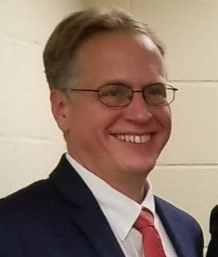
Lesson 1: Introduction to Christian Addiction Counseling Course Overview
Dr. Andrew Sears
President
City Vision University
www.cityvision.edu
Introduction to Christian Addiction Counseling
Free Course at www.cityvisioninstitute.org
Notes:
Why Important. We train Christians to serve the poor, addicted and underserved. My background. Michael’s Background. Largest program.

Slide 2
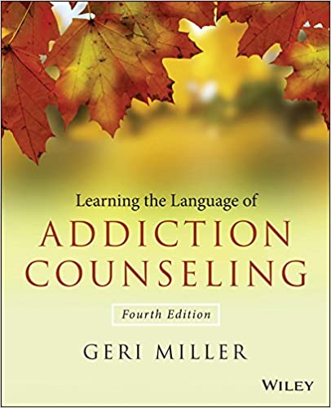
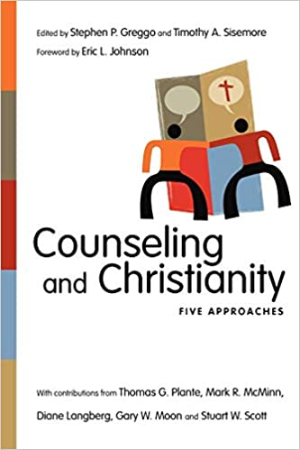
Required Reading for Course
Introduction to Addiction Counseling
Introduction to Christian Counseling
Notes:
Note on Urban vs. At-Risk
Videos show similar diversity of perspectives

Slide 3
Five Approaches to Counseling & Christianity
Biblical Counseling
Transformational
Counseling
Christian
Psychology
Integration
Model
Levels of Explanation
(secular)

Slide 4
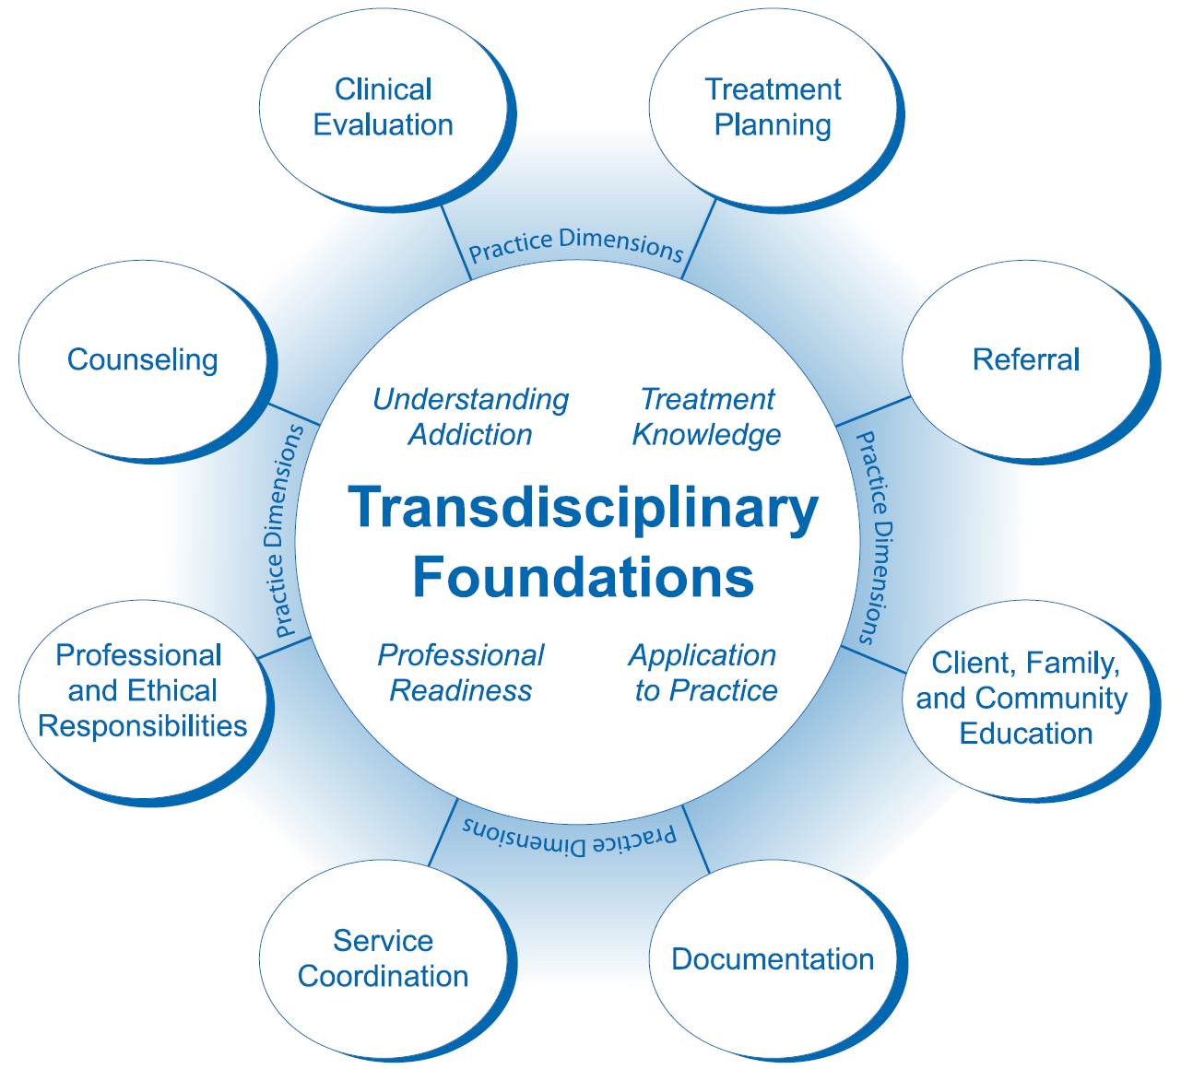
Eight Practice Domains of Addiction Counseling

Slide 5
Course Outcomes
After completing this course, you should be able to:
Describe each of five approaches to Counseling and Christianity including: Levels-of-Explanation, Integration, Christian Psychology, Transformational Counseling and Biblical Counseling.
Apply each of five approaches to Counseling and Christianity to a sample case: Levels-of-Explanation, Integration, Christian Psychology, Transformational Counseling and Biblical Counseling.
Reflect on their own values and those of any organization they may work for to assess which model of Christian counseling may be the best fit in various contexts and with various clients.
Describe each of the key elements of addiction counseling including: Assessment and Treatment, Co-Occurring Disorders, Behavioral Addictions, Relapse Prevention, Self-Help Groups, Addiction Counseling Techniques, Culturally Awareness and Development of the Counselor.

Slide 6
Course Outline by Week
Addiction Counseling Christian Counseling
Introduction to Christian Addiction Counseling
Assessment Process for Addiction Levels-of-Explanation Model
Co-Occurring Disorders & Behavioral Addictions Integration Model
Relapse Prevention, Self-Help Groups Christian Psychology Model
Techniques Specific to Addiction Counseling Transformational Counseling Model
Culturally Aware Addiction Counseling Biblical Counseling Model
Developing a Plan for Your Degree, Certification and Career in Addiction Counseling
Compassion Fatigue, Burnout, Secondary Trauma and Self-Care
Plan to spend an average of 17 hours per week on every three-credit course.

Slide 7
Educational Philosophy & Design of This Course
Create
Understand
Remember
Evaluate
Apply
Analyze
Final Paper
Assessment & Treatment Plans from
Each of the 5 Perspectives
Live Meetings
Forums
Take notes
Reinforce Content Retention with Reading & Videos
https://en.wikipedia.org/wiki/Bloom%27s_taxonomy

Slide 8
Addiction Counseling Licensing
States will have licensing model from NAADAC and/or IC&RC standards
Most states will require some combination of:
  Education Hours (City Vision courses typically count toward)
  Exam (City Vision courses are aligned to help you pass)
  Supervised Practicum Hours (can receive through practicum course)
  Work Experience Hours

Slide 9
Example Missouri CDAC & NAADAC NCAC
Missouri License NAADAC Certification
Certified Alcohol & Drug Counselor National Certified Addiction Counselor I
Education Hours 180 (local in MO) 270
Practicum Hours 300 None
Experience Hours BS: 2,000, AS: 3,000, HS: 4,000 6,000
Exam IC&RC ADC Exam IC&RC ADC Exam or NCAC Level 1
Other Active State License

Slide 10
Five Approaches to Counseling and Christianity: A Practical Guide
Dr. Andrew Sears
President
City Vision University
www.cityvision.edu
Introduction to Christian Addiction Counseling
Free Course at www.cityvisioninstitute.org

Slide 11
Five Approaches to Counseling & Christianity
Biblical Counseling
Transformational
Counseling
Christian
Psychology
Integration
Model
Levels of Explanation
(secular)

Slide 12
Five Approaches: Where Do You Work?
Biblical Counseling
Transformational
Counseling
Christian
Psychology
Integration
Model
Levels of Explanation
(secular)
Church
Scattered
(sent into
the world)
Church
Gathered
(not of
the world)
Primarily Pastors &
Christian Counselors
in Churches
Primarily Christian
Counselors in
Christian organizations
that take Insurance
Primarily Christian
Counselors in
Secular Organizations

Slide 13
Five Approaches: Do You Want to Be Licensed?
Biblical Counseling
Transformational
Counseling
Christian
Psychology
Integration
Model
Levels of Explanation
(secular)
Church
Scattered
(sent into
the world)
Church
Gathered
(not of
the world)
Biblical Counselors
Are Not Licensed
Unless They Pursue
Licensing and
Training from Another
Perspective
Licensed Counselors
(95%+ of jobs)
Notes:
Biblical counselors can be certified or ordained, but not licensed

Slide 14
Five Approaches: Who are Your Clients?
Biblical Counseling
Transformational
Counseling
Christian
Psychology
Integration
Model
Levels of Explanation
(secular)
Church
Scattered
(sent into
the world)
Church
Gathered
(not of
the world)
Most Clients are
Evangelical or
Fundamentalist
Most Clients are
Not Christian

Slide 15
Five Approaches: What is Your Call?
Biblical Counseling
Transformational
Counseling
Christian
Psychology
Integration
Model
Levels of Explanation
(secular)
Church
Scattered
(sent into
the world)
Church
Gathered
(not of
the world)
Mostly Pastors or
Lay Biblical Counselors
Scientist in
Psychology or
Practicing
Psychologist
Mostly Christians
Called as Witnesses
into Secular Contexts

Slide 16
Five Approaches: Where Are You Being Educated
Biblical Counseling
Transformational
Counseling
Christian
Psychology
Integration
Model
Levels of Explanation
(secular)
Church
Scattered
(sent into
the world)
Church
Gathered
(not of
the world)
Typically
Seminary,
Bible School
or Theology
Department
Secular University
or more Liberal
Christian University
Typically at a Christian
University in Counseling or
Psychology Department

Slide 17
How Strong is the Christian Worldview in Your Integration?
Weak (secularized)
Christian Worldview
Biblical Counseling
Transformational
Counseling
Christian
Psychology
Integration
Model
Levels of Explanation
(secular)
Church
Scattered
(sent into
the world)
Church
Gathered
(not of
the world)
Strong Christian
Worldview

Slide 18
Three Approaches to Counseling & Christianity
Anti-Integration
Christian
Counseling
Integration
Secular
Counseling
Church
Scattered
(sent into
the world)
Church
Gathered
(not of
the world)
Bible Only
Strong Integration: Bible Dominant
Weak Integration: Secular Dominant
Secular Only
Notes:
Explain difference between “Integration Model” and any model that does integration

Slide 19
Categorizing Three Dominant Cultures to Counseling & Christianity
Anti-Integration
Christian Integration
Secular
Primary Context
Where do you work?
Churches & Conservative
Missionary Organizations
Christian counseling centers
& universities
Secular counseling centers
Primary Clients
Who do you counsel?
Evangelical or Fundamentalist
Christians
Christian or Secular
Depending on Context
Non-Christian
Licensed?
Job access?
No
Few paid jobs unless pastor
Yes
Moderate level of jobs & pay
Yes
Highest level of jobs & pay
Approaches to Christian
Counseling
Traditional Biblical
Counseling
Integration, Christian Psychology
Transformational Counseling
Levels of Explanation
Anti-Religious Secularist
Where are you being
educated?
Seminaries, Bible Schools
or theology departments
Counseling Department
at Christian University
Secular University or More
Liberal Christian University
What is your call?
Mostly Pastors
Witnesses in Mixed Contexts
Witnesses in Secular Contexts
LGBT/Traditional Marriage
Traditional Marriage
Traditional Marriage for
Dominant Culture: LGBT valued
over traditional marriage
evangelicals
Risk of Christian Counselors
Being Secularized
Small
Moderate
High or already secularized
Common Quote
Sufficiency of Scripture
All truth is God’s truth
Religion is in a different domain
Risk: Legalism
High: conservative legalism
Low
High: liberal legalism

Slide 20
Five Approaches: Marking Boundaries
Biblical Counseling
Transformational
Counseling
Christian
Psychology
Integration
Model
Levels of Explanation
(secular)
Anyone Integrating
Psychology &
Christianity is likely
Going to Hell
Anti-Biblical Teachings
All Biblical Counseling is Evil
Church
Scattered
(sent into
the world)
Church
Gathered
(not of
the world)
Lausanne Statement Declaration on Care and Counsel as Mission (Cape Town)
(Founded by Billy Graham and represents 95% of evangelicals globally)

Slide 21


Why Learn Five Approaches to Counseling and Christianity?
“For now we see through a glass, darkly;
but then face to face: now I know in part;
but then shall I know even as also I am known.”
1 Corinthians 13:12
Need to equip students with different calls for a variety of
counseling settings for a range of clients.
Image Source: https://www.pinterest.com/pin/215821007131374920/
Notes:
Glasses vs. Tools.

Slide 22

Different Approaches and Balanced Diet for Well Rounded Christian Counseling Education

Slide 23
Different Approaches and Balanced Diet for Well Rounded Christian Counseling Education
Levels of
Explanation
Christian
Psychology
Integration
Biblical
Counseling
Transformational

Slide 24

All Tools Shape our Thinking and Worldview

Slide 25

Imbalance of Training in Secular Worldview vs. Christian Worldview
Practice &
Training in
Secular
Worldview
Practice &
Training in
Christian
Worldview
Image Source: https://www.mirror.co.uk/news/weird-news/man-giant-muscles-one-arm-3703950

Slide 26
Lesson 2: Levels of Explanation & Christian Counselors in Secular Contexts
Dr. Andrew Sears
President
City Vision University
www.cityvision.edu
Introduction to Christian Addiction Counseling
Free Course at www.cityvisioninstitute.org

Slide 27
Five Approaches: Where Do You Work?
Biblical Counseling
Transformational
Counseling
Christian
Psychology
Christian Integration
Levels of Explanation
(secular)
Church
Scattered
(sent into
the world)
Church
Gathered
(not of
the world)
Primarily Christian
Counselors
in Churches
Primarily Christian
Counselors in
Christian organizations
that take Insurance
Primarily Christian
Counselors in
Secular Organizations or
in “public square”

Slide 28
Levels-of-Explanation Model
Humans are best understood in terms of a hierarchy of levels or disciplines of relative complexity that should not be confused
Theology
Psychology
Biology
Chemistry
Therefore, one’s faith should not affect the other levels or disciplines
Adapted from slides from Eric Johnson Presentation at https://foclonline.org/sites/live.foclonline.org//files/johnson_eric_christianity_psychology_outline.pdf

Slide 29
Levels-of-Explanation Model
Strengths
1. Takes science and research very seriously
2. Allows all scientists to contribute to their discipline, regardless of worldview differences
3. Avoids problems with misinterpreting the Bible, like what happened regarding the earth’s position in the solar system
4. Has shaped contemporary psychology in areas like psychology of religion, forgiveness, and values in therapy
Adapted from slides from Eric Johnson Presentation at https://foclonline.org/sites/live.foclonline.org//files/johnson_eric_christianity_psychology_outline.pdf

Slide 30
Levels-of-Explanation Model
Weaknesses
1. Prevents worldviews from exercising influence, except for secularist worldview!
2. Secularism is unfair to Christians. Forbids Christians to work within their worldview/prevents use of Christian values in public mental health facilities
3. Excludes Bible from contributing to psychology
4. Can easily lead to syncretism and the importation of modern values regarding topics like homosexuality (D. Myers)
Adapted from slides from Eric Johnson Presentation at https://foclonline.org/sites/live.foclonline.org//files/johnson_eric_christianity_psychology_outline.pdf

Slide 31
Dualism Heresy: Secular-Sacred Divide
Sacred
Personal beliefs
Church/religion
Sunday
Secular
Counseling/Psychology
Science
The other 6 days
“The sacred-secular dualism is the worst heresy of the Christian church worldwide” – R. Paul Stevens
The whole world is sacred and under God. Ephesians 4:6, Isaiah 6:3, Psalm 139:8
Notes:
“[There is] one God and Father of all, who is over all and through all and in all.” (Ephesians 4:6)
“And one called to another and said: ‘Holy, holy, holy is the Lord of hosts; the whole earth is full of his glory!’” (Isaiah 6:3)
“If I ascend to heaven, you are there! If I make my bed in Sheol, you are there!” (Psalm 139:8)

Slide 32
Christian Systems Theory
Christian Systems Theory is an attempt to translate “levels of explanation” into a Christian context that is more holistic and avoids dualism
All Models Are Flawed
  There is “sin” built into all models and perspectives
  “No area of science, society, or culture is perfect or neutral. It is essential to recognize, critique, and respond to the implicit ethics, forms of power, and/or oppression embedded in them.”- Lausanne Declaration on Care and Counsel as Mission
Strengths
  Helps students to understand all the dimensions of holistic treatment
Weaknesses
  Can inadvertently cause students to view Bible & theology as just one among many academic disciplines rather than being a more foundational lens or worldview from which to interpret other disciplines

Slide 33
How Universities are Typically Organized
Q1 Personal: Nurture (Humanities)
(I/mind)
Q2: Physical: Nature (Science & Technology)
(it/body)
Humanities
Western Theology
Ministry
Art for Self
Biology
Chemistry
Physics
Engineering
Medicine/Psychiatry
Healthcare/Life Sciences
Individual
Counseling
Psychology
Q3: Cultural
(we)
Q4: Societal (Social Sciences)
(they)
Gender studies
Cultural studies
Anthropology
Ethics
Non-Western religions/theology
Music/Worship
Art for others
Micro
Organizational & Business Management
Microeconomics
Macro
Sociology
Law, Political Science
Economics
History
Ecology
Collective
Internal (more subjective)
External (more objective)

Slide 34
How Christian Worldview informs Christian Universities
Q1 Personal: Nurture (Humanities & Social Sciences)
Q2: Physical: Nature (Science & Technology)
Humanities
Western Theology
Ministry
Counseling
Psychology
Art for Self
Biology
Chemistry
Physics
Engineering
Medicine/Psychiatry
Healthcare/Life Sciences
Individual
All Disciplines Interpreted through
Lens of a Christian Worldview
Q3: Cultural
Q4: Societal (Social Sciences)
Gender studies
Cultural studies
Anthropology
Ethics
Non-Western religions/theology
Music/Worship
Art for others
Micro
Organizational & Business Management
Microeconomics
Macro
Sociology
Law, Political Science
Economics
History
Ecology
Collective
Internal (more subjective)
External (more objective)

Slide 35
A Christian Systems Approach to Understanding Causes of Addiction (Assessment)
Q1 Personal: Nurture (Humanities)
Q2: Physical: Nature (Science & Technology)
Unemployment
Lack of emotional intelligence
Personal isolation/broken relationships
Spiritual emptiness
Wounds from abuse
Separation from God
Biochemistry of addiction
Medical Treatments
Hereditary predisposition
Easy access to drugs/addiction
Lack of physical care of bodies
Biophysical emotional predisposition
Individual
Q3: Cultural
Q4: Societal (Social Sciences)
Cultural devaluation of emotion,
spiritual, relationships, etc.
Subcultures where addiction is norm
Drugs, alcohol, sex, food & materialism
promoted in mass media
Current cultural oppression (racism, etc.)
Cultural inheritance from past oppression
“Worship” of sex, hedonism and other
“gods” permeates culture
Breakdown of family
Lack of jobs
Systemic Oppression (Racism, etc.)
Political priorities
Economics of drug trade
Global exploitation
Failed States/Governments
Globalization of crime
Collective
Internal
External
Notes:
Applying systemic theology to a current problem like addiction helps explain how systemic theology can be helpful.
Most problems like addiction have multiple inter-related causes.
Using the four quadrants and the different fields in each quadrant helps to understand different potential causes.
We often try to simplify things into one cause, and we have big debates over which item is the only cause.
These debates often can be summarized as “I believe Quadrant x is the most important (because of my predisposition) vs. I believe Quadrant y is the most important (based on my predisposition).”
If we understand multifaceted systemic causes, we can come up with a multifaceted solution.

Slide 36
A Christian Systems Approach to Understanding Causes of Addiction (Treatment) Plan)
Q1 Personal: Nurture (Humanities)
Q2: Physical: Nature (Science & Technology)
Get a job
Go to Counseling
Get healthy friendships
Form identity
Establish physical & emotional safety
Pursue spiritual fulfillment
Get healing from wounds of abuse
Get connected to God
Assistance with physical needs
Get on proper psychotropic medication
Remove access to addictive item
Avoid HALT (Hungry, Angry, Lonely, Tired)
Individual
Q3: Cultural
Q4: Societal (Social Sciences)
Spiritual revival
Pursue or create subcultures that value
emotion, spiritual, relationships, etc.
Avoid subcultures where addiction is norm
Avoid triggering mass media
Pursue groups that help to cope with
cultural oppression
Pursue groups that positively address
cultural inheritance from past oppression
Immerse in culture that worships God
Micro (development)
Community development organizations
Micro-economic development
Macro (advocacy & structural change)
Just laws & policies
Healthy social structures
Just teaching of history (Black history, etc.)
Macro-economic development
Collective
Internal
External
Notes:
Applying systemic theology to a current problem like addiction helps explain how systemic theology can be helpful.
Most problems like addiction have multiple inter-related causes.
Using the four quadrants and the different fields in each quadrant helps to understand different potential causes.
We often try to simplify things into one cause, and we have big debates over which item is the only cause.
These debates often can be summarized as “I believe Quadrant x is the most important (because of my predisposition) vs. I believe Quadrant y is the most important (based on my predisposition).”
If we understand multifaceted systemic causes, we can come up with a multifaceted solution.

Slide 37
Biblical Understanding of Authority
Assess what authorities you will come under
  Biblical or Pastoral Counseling (typically no licensing, but often under church or denominational authority i.e. ordination)
  Licensing (code of ethics)
  Employer (Christian or secular)
  Insurance
  Government reimbursement (Medicaid)
Once you decide whose authority you will come under, then honor that authority and follow it
  Code of ethics (state licensing boards, NAADAC, ACA)
  Employer, insurance, government
Licensing and dominant forms of education in counseling is based in a secular worldview

Slide 38
Biblical Guidance on Secular vs. Christian Workplace
Submitting to Authority
  Romans 13:1 - "Let everyone be subject to the governing authorities, for there is no authority except that which God has established. The authorities that exist have been established by God."
  Similar statements in 1 Peter 2:13-14, Hebrews 13:17
Limits & Civil Disobedience
  Daniel
  In Acts 4:10 & 5:28, Peter & John said “'We must obey God rather than men.“’
  See: https://www.desiringgod.org/messages/the-limits-of-submission-to-man
Other Biblical Wisdom
  What is your call and your role in the Body of Christ? 1 Corinthians 7:14, 12:12-27
  Count the cost. Luke 14:27-33

Slide 39
Levels of Government Authorities
Licensed
Center
Tax Exempt Status
Legal Right to Exist
Accept Medicaid or Federal Grants
Licensed Counselors
Accept Insurance
State & Federal Authority on Organization
Federal Authority
Insurance Company Authority
State Authority on Individuals
All Churches
& Nonprofits
Notes:
This is a detailed commentary on Rom. 13 and Acts 4 & 5 that may be relevant - https://ca.thegospelcoalition.org/article/does-a-bad-government-deserve-to-be-disobeyed/
this explanation of Matt. 22:21 may also be relevant - https://www.gotquestions.org/render-to-Caesar.html

Slide 40
Lesson 3: Counseling Integration Model and Christian Worldview
Dr. Andrew Sears
President
City Vision University
www.cityvision.edu
Introduction to Christian Addiction Counseling
Free Course at www.cityvisioninstitute.org
Notes:
Integration in the Public Square, Integration

Slide 41
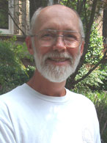
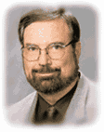
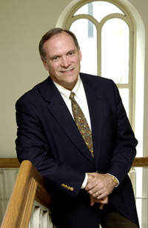

Integration Model
Major representatives
Bruce Narramore
Mark McMinn
Everett
Worthington
Stan Jones
Dominant approach at Christian graduate schools
Adapted from slides from Eric Johnson Presentation at https://foclonline.org/sites/live.foclonline.org//files/johnson_eric_christianity_psychology_outline.pdf

Slide 42
Integration Model
Major Orientations
1. Interdisciplinary Integration (majority position)
Goal is the integration of psychology and theology
2. Worldview Integration (Jones & Butman, 1991)
Goal is the proper interpretation of modern psychology according to a Christian worldview
3. Ethical Integration (popular among postmoderns)
Goal is to live Christianly in one’s personal and professional life
Adapted from slides from Eric Johnson Presentation at https://foclonline.org/sites/live.foclonline.org//files/johnson_eric_christianity_psychology_outline.pdf

Slide 43
Integration Model
Common Slogan
“All Truth is God’s Truth”
Key Insight
God is glorified when Christians make use of his truth
Limitation
The way the slogan is often used seems to imply that all secular psychology is true
Adapted from slides from Eric Johnson Presentation at https://foclonline.org/sites/live.foclonline.org//files/johnson_eric_christianity_psychology_outline.pdf

Slide 44
Integration Model
Comparing Quality of Integration
1. Strong Integration
Christian thought makes a real impact
Examples: Jones & Butman, McMinn, Tan, Sandage
2. Weak Integration
Christianity makes no substantial impact
Examples: Carter & Narramore, and many who use the term
Adapted from slides from Eric Johnson Presentation at https://foclonline.org/sites/live.foclonline.org//files/johnson_eric_christianity_psychology_outline.pdf

Slide 45
Integration Model
Strengths
1. Takes science and research seriously
2. Allows Christian faith to reinterpret psychology
3. Recognizes the role of God’s “creation grace” in culture and science
4. Seeks to engage the culture and impact contemporary psychology
Adapted from slides from Eric Johnson Presentation at https://foclonline.org/sites/live.foclonline.org//files/johnson_eric_christianity_psychology_outline.pdf
Notes:
Creation grace = common grace

Slide 46
Integration Model
Weaknesses
1. Assumes a dualistic separation between biblical research and research on human beings
2. Assumes that modern psychology is the real legitimate version of psychology/Allows secularism to set the agenda for psychology
3. Minimizes the distorting effects of sin on our understanding = the “Antithesis”
4. Poor integration undermines the lordship of Christ and the impact of redemption (esp. in counseling)
Adapted from slides from Eric Johnson Presentation at https://foclonline.org/sites/live.foclonline.org//files/johnson_eric_christianity_psychology_outline.pdf

Slide 47
Range of Christian Integration Among Models
Biblical Counseling
Transformational
Counseling
Christian
Psychology
Integration
Model
Levels of Explanation
(secular)
Oppositional to any
attempt at integration
All Bible, No Science
Oppositional to any
attempt at integration
All Science, No Bible
Church
Scattered
(sent into
the world)
Church
Gathered
(not of
the world)
Primarily Christian
Counselors
in Churches
Primarily Christian
Counselors in
Christian organizations
that take Insurance
Primarily Christian
Counselors in
Secular Organizations
Some level of integration between Christianity & Psychology

Slide 48
Christian vs. Secular Counseling Worldview
Christian Worldview Secular Counseling Worldview
Base Worldview Christian Worldview Secular Scientific Naturalism
Fundamental Problem? Sin Psychological Problem
Solution? Salvation Counseling
Who are we? In God’s Image but fallen Thinking animals/Collection of atoms
Where we came from? God Accidental Cosmic Chance
Philosophy? Spiritual, wholistic Materialist, reductionist
Values Bible-based Pretends (falsely) to be value-free
How should I live? Love God, Love Others Individual Pleasure Maximizing/Self Actualization

Slide 49
How Strong is the Christian Worldview in Your Integration?
Weak (secularized)
Christian Worldview
Biblical Counseling
Transformational
Counseling
Christian
Psychology
Christian Integration
Levels of Explanation
(secular)
Church
Scattered
(sent into
the world)
Church
Gathered
(not of
the world)
Christians engaging
in “public square”
Strong Christian
Worldview

Slide 50

Weak Integration: The Problem with a Christmas Tree Approach to Christian Integration
Christian
Concept
Secular
Worldview

Slide 51

Strong Integration: Applying Learning into a Christian Worldview
Christian Worldview
Principles from Humanities
Truths from
Sciences
Learning
from
Cultural
Studies
Lessons
From
Social
Sciences

Slide 52
How Christian Worldview informs Christian Universities
Q1 Personal: Nurture (Humanities & Social Sciences)
Q2: Physical: Nature (Science & Technology)
Humanities
Western Theology
Ministry
Counseling
Psychology
Art for Self
Biology
Chemistry
Physics
Engineering
Medicine/Psychiatry
Healthcare/Life Sciences
Individual
All Disciplines Interpreted through
Lens of a Christian Worldview
Q3: Cultural
Q4: Societal (Social Sciences)
Gender studies
Cultural studies
Anthropology
Ethics
Non-Western religions/theology
Music/Worship
Art for others
Micro
Organizational & Business Management
Microeconomics
Macro
Sociology
Law, Political Science
Economics
History
Ecology
Collective
Internal (more subjective)
External (more objective)

Slide 53
Different Approaches and Balanced Diet for Well Rounded Christian Counseling Education
Levels of
Explanation
Christian
Psychology
Integration
Biblical
Counseling
Transformational

Slide 54
How Many Christians are Trained in Counseling
Secular Training
in Counseling
Training in
Christian
Integration
Christian
Psychology
Integration
Church on
Sundays
Biblical
Counseling
Transformational

Slide 55
How Many Christians are Trained in Counseling
Secular Training in Counseling
Christian
Psychology
Integration
Church on
Sundays
Biblical
Counseling
Transformational

Slide 56
All Tools Shape our Thinking and Worldview

Slide 57
Imbalance of Training in Secular Worldview vs. Christian Worldview
Training in
Secular
Worldview
Training in
Christian
Worldview
Image Source: https://www.mirror.co.uk/news/weird-news/man-giant-muscles-one-arm-3703950

Slide 58
Why Some Say All Integration is Harmful
The cultural tendency of any dominant culture (secular counseling) is to assimilate, so most Christian integration results in the secular counseling worldview dominating
  Many in the field have seen strong Christians lose their faith through this process
  Assimilation happens through dominant worldview in training materials, relationships with others in the field, funding sources, government and insurance policies
  Some view it like whether Christians should drink even a little alcohol. Too often, it becomes a problem with people who start just drinking a little, so it’s better avoided.
Developing a strong integration perspective where Christian worldview is dominant takes a lot of study and effort
  Being a strong Christian and learning secular counseling doesn’t magically create integration between the two. Christian counseling integration is its own field.
  This is what good faculty in Christian counseling programs spend their lifetimes studying.
There is a long history of Christian organizations being assimilated and secularizing through mission/worldview creep
  Vast majority of counseling funding requires secular worldview and following secular guidelines, so many organizations chase the funding and lose their original core mission.
  Formerly Christian colleges, YMCA, rescue missions that secularized

Slide 59
What is Different about Christian Education at City Vision
City Vision Course Christian Worldview Integration
Introduction to Christian Addiction Counseling Deep Christian Worldview Integration
Spirituality & Addiction Redeeming the 12 Step Model
Drugs of Abuse Strong Science + Biblical Caution on Drug Use
Counseling in Urban & Multicultural Environments Deep Understanding of Cross-Cultural Ministry
Technology, Life Balance & Behavioral Addictions Christian Understanding of Behavioral Addictions
Family Issues & Recovery Christian worldview of family and development
Sexual Issues in Addiction Christian worldview of sexual addiction
Group Counseling Practices Secular groups & Christian groups
Mental Illness, Addiction & Dual Diagnosis Christian understanding of diagnosis & medications
Counseling Alcoholics 12-steps in Christian and secular contexts
Chaplaincy Chaplaincy in Christian and secular context
Vocation, Calling & Purpose of Work Christian understanding of vocation
Managing Residential Recovery Programs Designed for Christian ministries

Slide 60
Why is this Important?
To help you further solidify your own faith and recovery process if you are in recovery
To prepare you to retain a strong Christian faith and worldview if you work in secular contexts
To help you develop deep integration of Christian worldview into your understanding of counseling if you either work in a Christian context or work with Christian clients in a secular context
To help you stay current in a rapidly changing field while applying Biblical wisdom in evaluating new practices
To give you tools to make critical decisions if you become a leader in your profession: program design, training programs, referral strategy, policies on medications, etc.

Slide 61
Lesson 4: Christian Psychology Model
Dr. Andrew Sears
President
City Vision University
www.cityvision.edu
Introduction to Christian Addiction Counseling
Free Course at www.cityvisioninstitute.org

Slide 62



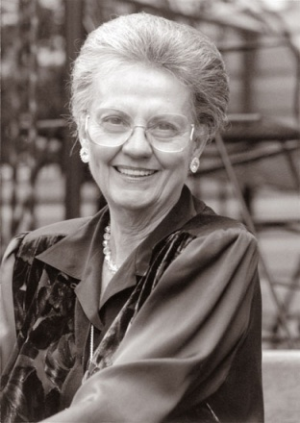
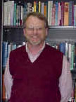
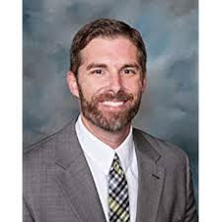
Christian Psychology Model
Major representatives: Contemporary
Leanne Payne
Paul Vitz
Diane Langberg
Robert Roberts
Paul J. Watson
Joshua
Knabb
Adapted from slides from Eric Johnson Presentation at https://foclonline.org/sites/live.foclonline.org//files/johnson_eric_christianity_psychology_outline.pdf

Slide 63
Christian Psychology Model
The agenda of a Christian Psychology
A Christian psychology will not differ noticeably in every respect from modern or postmodern psychology.
Only where the psychological feature is worldview dependent
Adapted from slides from Eric Johnson Presentation at https://foclonline.org/sites/live.foclonline.org//files/johnson_eric_christianity_psychology_outline.pdf

Slide 64
Christian Psychology Model
What areas of psychology are not so worldview dependent?
1. Biological mechanics: genetics and neuropsychology, drive motivation
2. Psychological mechanics: animal learning, memory, reasoning, intelligence, language, emotion, school learning, action
3. Social processes: family influences, group dynamics, social skills, social influence
Adapted from slides from Eric Johnson Presentation at https://foclonline.org/sites/live.foclonline.org//files/johnson_eric_christianity_psychology_outline.pdf

Slide 65
Christian Psychology Model
What areas of psychology are more worldview dependent?
Those that are…
the most subject to sociocultural influence
the most complex
the most existential
and the understanding of which is the most value-laden
Adapted from slides from Eric Johnson Presentation at https://foclonline.org/sites/live.foclonline.org//files/johnson_eric_christianity_psychology_outline.pdf

Slide 66
Christian Psychology Model
What areas of psychology are more worldview dependent?
1. Higher human motivation/uniquely human
2. Personality structures and processes
3. Psychopathology
4. Definitions of human maturity and flourishing
5. Healing of the soul / psychotherapy, counseling
6. Interpretation of complex social phenomena like attribution, love, relations between motives, and ethical and spiritual dynamics
Adapted from slides from Eric Johnson Presentation at https://foclonline.org/sites/live.foclonline.org//files/johnson_eric_christianity_psychology_outline.pdf

Slide 67
Christian Psychology Worldview
What major distinctives will characterize
a Christian psychology worldview?
1. God is the center of human life
2. Humans are situated within a grand theo-drama in which the triune God is gradually and increasingly manifesting himself and his glory. This theo-drama can be summarized as creation, fall, redemption, and consummation
Adapted from slides from Eric Johnson Presentation at https://foclonline.org/sites/live.foclonline.org//files/johnson_eric_christianity_psychology_outline.pdf

Slide 68
Christian Psychology Model
What major distinctives will characterize
a Christian psychology worldview?
3. Creation: Humans are made in God’s image
4. Fall: Humans are sinners and primordially alienated from God and neighbor
5. Redemption: The appropriation by faith of Christ’s work of redemption is necessary for proper human maturity, coping, healing, and strengthening—of great importance for counseling
Adapted from slides from Eric Johnson Presentation at https://foclonline.org/sites/live.foclonline.org//files/johnson_eric_christianity_psychology_outline.pdf

Slide 69
Christian Psychology Model
What major distinctives will characterize
a Christian psychology worldview?
6. Consummation: Human life is oriented to an eternal future with God
7. A four dimensional relational model of human life
Adapted from slides from Eric Johnson Presentation at https://foclonline.org/sites/live.foclonline.org//files/johnson_eric_christianity_psychology_outline.pdf

Slide 70
Christian Worldview vs. Materialist Worldview
(In contrast to the one- or two-dimensional models of secular psychology)

Slide 71
Models of the Person
Biological is
Physically Foundational
Spiritual is All Inclusive

Slide 72
Christian Framework for Psychopathology (disease of the soul)
1. Sin is when we cause
these to be out of order
Original Sin
Personal Sin
Suffering
2. Weakness or poverty (astheneia) is damage to God’s creation not due to personal sin
Biological damage
Psychological damage
Social damage
Source: Eric Johnson https://www.youtube.com/watch?v=90Z2DsXT8O8
Notes:
Eric Johnson
Three aspects of sin: https://www.youtube.com/watch?v=90Z2DsXT8O8 (43 min)
Original Sin
Personal Sin
Suffering (some your fault and some not your fault)
Sin is the worst type of psychopathology
Bio, Psycho, Social Damage: Astheneia
https://www.blueletterbible.org/lang/lexicon/lexicon.cfm?t=kjv&strongs=g769
https://www.bibletools.org/index.cfm/fuseaction/Lexicon.show/ID/G769/astheneia.htm
Weakness. Most common work for physical illness and also used for being poor.
Any type of physical, psychological or spiritual limitation
Examples:
Night Jesus betrayed: Spirit is willing but the flesh is weak
Paul don’t know how to pray as we ought because of our weakness (cognitive)
Some believers are weak because they are legalistic
Best summary is 2 Corinthians: thorn in flesh, brags about his weakness, shows power belongs to God
Implications: autism, severe mental impairment (not caused by self), hallucination, paranoia (in schizophrenia), depression from child abuse
Uses word fault (sin and weakness together) some our fault and some others fault

Slide 73
Range of Christian Integration Among Models
Biblical Counseling
Transformational
Counseling
Christian
Psychology
Integration
Model
Levels of Explanation
(secular)
Oppositional to any
attempt at integration
Oppositional to any
attempt at integration
Church
Scattered
(sent into
the world)
Church
Gathered
(not of
the world)
Primarily Pastors &
Counselors
in Churches
Primarily Christian
Counselors in
Christian organizations
that take Insurance
Primarily Christian
Counselors in
Secular Organizations
Some level of integration between Christianity & Psychology
Strong Integration: Bible Dominant
Weak Integration: Secular Dominant

Slide 74

Weaknesses of Christian Psychology Model
Psychology (theory, research, head) vs. Counseling (practice, heart, hands)
Those trying to follow Christian Psychology model could have the same tendencies toward weak integration as other integration models

Slide 75
Lesson 5: Transformative Model: Combining Spiritual Formation and Counseling
Dr. Andrew Sears
President
City Vision University
www.cityvision.edu
Introduction to Christian Addiction Counseling
Free Course at www.cityvisioninstitute.org

Slide 76

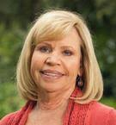
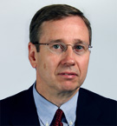
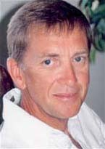
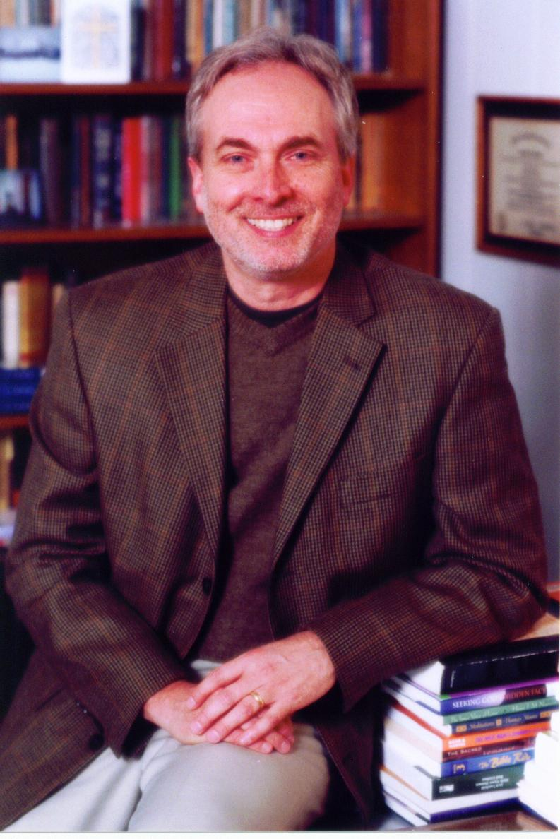
Transformative-Spirituality Model
Major representatives
Gary Moon
David Benner
Larry Crabb
Judy
Ten Elshoff
John Coe
Institute of
Spiritual Formation
Adapted from slides from Eric Johnson Presentation at https://foclonline.org/sites/live.foclonline.org//files/johnson_eric_christianity_psychology_outline.pdf

Slide 77
Transformative-Spirituality Model
Major Themes
Spiritual formation into the image of Christ is the primary goal of human life
Spiritual direction provides soul care guidance to others by those further along the path
Uses distinctly Christian resources to promote healing and development
Adapted from slides from Eric Johnson Presentation at https://foclonline.org/sites/live.foclonline.org//files/johnson_eric_christianity_psychology_outline.pdf

Slide 78
Wesleyan Quadrilateral and Counseling Approaches
Scripture
(Biblical Counseling)
Tradition
(Christian Psychology)
Experience
(Transformative
Counseling)
Reason
(Levels of Explanation +
Weak Integration)
Strong
Integration
Adapted from: Gary Moon https://www.youtube.com/watch?v=LGspnXjEGAY

Slide 79
Transformative Counseling & Other Traditions
Christian Counseling
Spiritual Direction
Spiritual Formation
Spiritual Disciplines
Transformative
Spirituality
Model

Slide 80
Spiritual Formation, Disciplines & Direction
Spiritual Formation: process that improves spiritual growth
  i.e. mentoring, counseling, Christian college, small groups
Spiritual Disciplines: tools that help improve spiritual formation
  i.e. Bible study, prayer, fasting, meditation, worship, solitude, service
Spiritual Direction: process of helping someone improve their intimacy with God, discern God’s presence and direction in their lives
  i.e. Meeting with Spiritual Director, pastor or counselor for spiritual direction
Each of these have a wealth of tradition and resources to build from

Slide 81
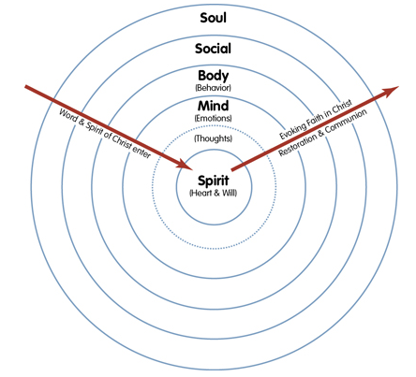
Spiritual Formation Model (Willard)

Slide 82
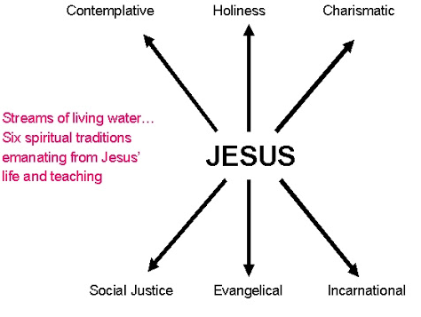
Transformational Counseling & Six Spiritual Traditions

Slide 83
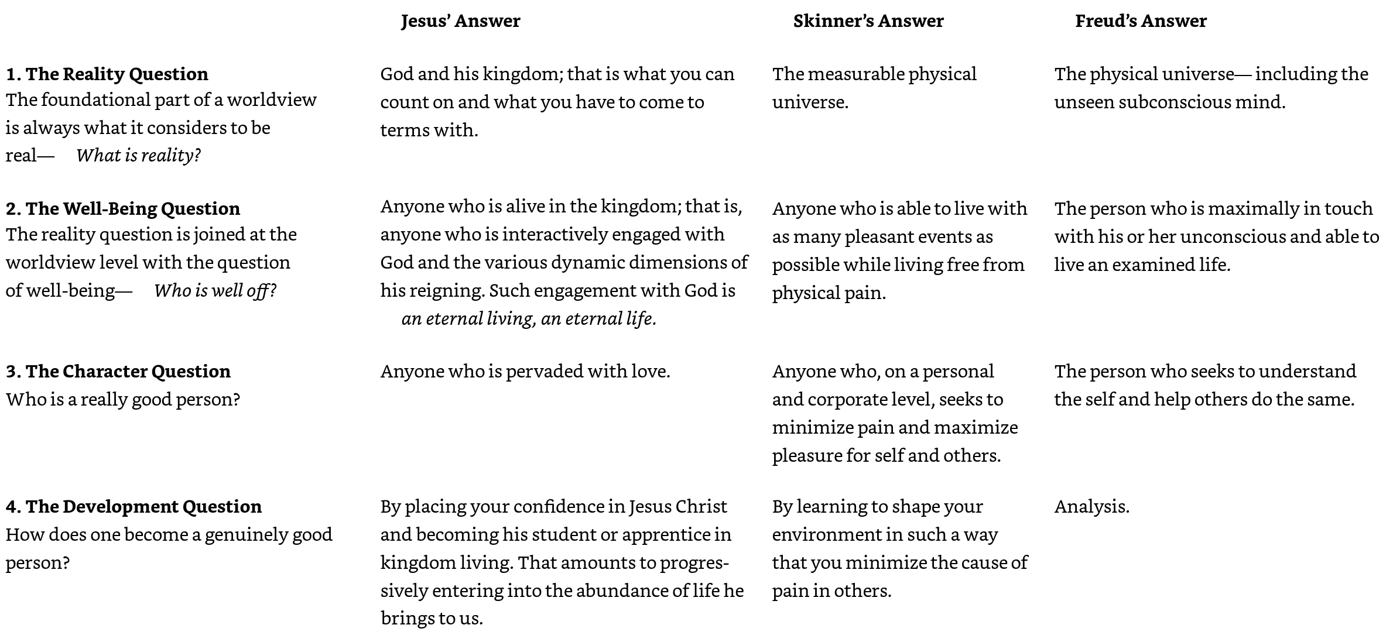
Transformational Counseling Worldview vs. Secular Psychology
(Behavioral Psychology)
(Psychoanalysis)
Source: Greggo, Stephen P.; Sisemore, Timothy A.. Counseling and Christianity (Christian Association for Psychological Studies Books) (p. 139). InterVarsity Press. Kindle Edition.

Slide 84
Transformational Counseling Worldview vs. Secular Psychology
(Behavioral Psychology)
(Psychoanalysis)
Source: Greggo, Stephen P.; Sisemore, Timothy A.. Counseling and Christianity (Christian Association for Psychological Studies Books) (p. 139). InterVarsity Press. Kindle Edition.

Slide 85
Transformative-Spirituality Model
Strengths
1. Christ-centered approach to the care of souls
2. Takes the Bible and Christian traditions very seriously
3. Not focused on an increase in knowledge, as much as on changing everyone’s heart and character in Christ, incl. the professor and therapist
Adapted from slides from Eric Johnson Presentation at https://foclonline.org/sites/live.foclonline.org//files/johnson_eric_christianity_psychology_outline.pdf

Slide 86
Transformative-Spirituality Model
Weaknesses
1. Some advocates consider spirituality and psychology two separate disciplines
2. Spiritual directors use spiritual resources, but for more serious problems, they defer to secular therapy models
But the majority do not make such a dichotomy
3. Favors Catholic and Orthodox spirituality over Protestant
Adapted from slides from Eric Johnson Presentation at https://foclonline.org/sites/live.foclonline.org//files/johnson_eric_christianity_psychology_outline.pdf

Slide 87
Lesson 6: Biblical Counseling Model
Dr. Andrew Sears
President
City Vision University
www.cityvision.edu
Introduction to Christian Addiction Counseling
Free Course at www.cityvisioninstitute.org

Slide 88
Five Approaches: Where Do You Work?
Biblical Counseling
Transformational
Counseling
Christian
Psychology
Integration
Model
Levels of Explanation
(secular)
Mostly taught
In Seminary,
Bible School
or Theology
Department
Church
Scattered
(sent into
the world)
Church
Gathered
(not of
the world)
Primarily Pastors, Lay
Counselors & Christian
Counselors in Churches
Primarily Christian
Counselors in
Christian organizations
that take Insurance
Primarily Christian
Counselors in
Secular Organizations

Slide 89
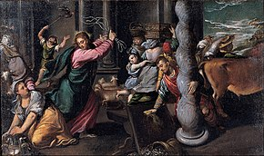
Biblical Counseling & Jesus Cleansing the Temple
Was Jesus against all money changing?
  He was against money changing in the temple
Similarly, within the local church, we should be protective against encroachment of a secular worldview into churches & Christian organizations

Slide 90
The Problem with Integration Approaches: Most are Practiced as Weak Integration
Biblical Counseling
Transformational
Counseling
Christian
Psychology
Integration
Model
Levels of Explanation
(secular)
Oppositional to any
attempt at integration
Oppositional to any
attempt at integration
Church
Scattered
(sent into
the world)
Church
Gathered
(not of
the world)
Primarily Christian
Counselors
in Churches
Primarily Christian
Counselors in
Christian organizations
that take Insurance
Primarily Christian
Counselors in
Secular Organizations
Some level of integration between Christianity & Psychology

Slide 91
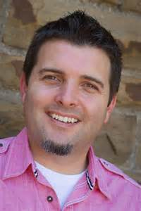

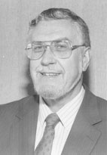
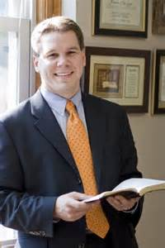

Biblical Counseling Model
Major representatives
Jay Adams
David Powlison
Jeremy Lelek ABC
Ed Welch
Heath Lambert ACBC

Slide 92
Biblical Counseling Model
Counseling that is based exclusively on the Bible (and theology)
Concern about the influence of secularism on modern psychology, so skeptical about integration
Sin is the primary focus of counsel ing
So gospel is the primary solution
Adapted from slides from Eric Johnson Presentation at https://foclonline.org/sites/live.foclonline.org//files/johnson_eric_christianity_psychology_outline.pdf

Slide 93
Biblical Counseling Model
Common Slogan
“The Sufficiency of Scripture”
Key Insight
Scripture is authoritative and necessary for Christian counseling because it is God’s soul care guidebook
Limitation
The way the slogan is often used seems to imply that the Bible is scientifically sufficient, and its content directly addresses all counseling matters comprehensively
(All Bible, No Science)
Adapted from slides from Eric Johnson Presentation at https://foclonline.org/sites/live.foclonline.org//files/johnson_eric_christianity_psychology_outline.pdf

Slide 94
Biblical Counseling Model
Major Orientations
1. Traditional Biblical Counseling (Adams, Mack)
a. Anti-psychology, anti-licensure, anti-medication
b. Assumes a dualistic separation between biblical research and research on human beings
c. Negativistic, judgmental tone towards others
d. Superficial understanding of sin
* Focus on behavior
* Repent and all will be well
* Lack of awareness of subtle, remaining sin
Adapted from slides from Eric Johnson Presentation at https://foclonline.org/sites/live.foclonline.org//files/johnson_eric_christianity_psychology_outline.pdf
Notes:
More aligned with fundamentalist

Slide 95
Biblical Counseling Model
Major Orientations
2. Progressive Biblical Counseling (CCEF, SEBTS, CBS)
a. Very cautious about modern psychology, but more open to learn from extrabiblical sources
b. Greater willingness to dialogue with others
c. More sophisticated understanding of sin
* Focus on the heart
* Focus on “idols”
* Willingness to develop relationship and take as long as necessary
Adapted from slides from Eric Johnson Presentation at https://foclonline.org/sites/live.foclonline.org//files/johnson_eric_christianity_psychology_outline.pdf
Notes:
More aligned with Evangelicals

Slide 96
Traditional Biblical Counseling: Bible is the Only Source
Biblical
Counseling
Christian
Psychology
Integration
Biblical
Counseling
Transformational

Slide 97
Progressive Biblical Counseling: Biblical Counseling Should be the Food Served by the Church
Levels of
Explanation
Christian
Psychology
Integration
Church
Scattered
Christians may
need to use
other
frameworks
Approach:
The Church &
similar ministries
should use the
Biblical Counseling
framework
Biblical
Counseling
Transformational

Slide 98
Biblical Counseling Model: Strengths
Bible is God’s word for soul care; BCM takes the Bible seriously
Wary of the implicit worldview influences of secularism on modern psychology; want to avoid syncretism
Strive for a theocentric approach to soul care that sees sin as our worst problem and Christ’s work as the cure for the sin-sick soul
Can be effective at raising up lay-counselors
Avoids most government entanglements because non-licensed

Slide 99
Biblical Counseling Model: Limitations
Biblical counseling works best with pastors in a “church gathered” context and can fail to recognize that other models may be helpful in a “church scattered” with Christians sent out into more secular contexts
Biblical counseling can tend to be oppositional to other models
Biblical counseling that resist any referrals to outside help can create risks for clients who have significant mental illness

Slide 100
How Some Ministries Can Unintentionally Become Functionally Dualistic
Sacred
Only refer clients to schools that are purely
traditional Biblical counseling rather than
Christian schools that train for licensure
Most clients are unable to get jobs from
Biblical counseling training outside the
church/ministry without licensure
Secular
Refer clients wanting addiction counseling licensure exclusively to secular training
Clients are immersed in a secular worldview
Clients never reconcile secular and Christian worldviews resulting in more clients leaving the program and the faith:
“I can’t be a Christian and pursue my calling.”
Role of City Vision’s Addiction Counseling Program
A major purpose of City Vision’s Addiction Counseling is to avoid this functional dualism
City Vision provides courses for Addiction Counseling licensure within a Christian worldview
City Vision’s tuition is completely covered for most residential recovery clients through Pell grants

Slide 101
The Problem with Hostility to All Integration, but Partnering with Secular Training
Biblical Counseling
Transformational
Counseling
Christian
Psychology
Integration
Model
Levels of Explanation
(secular)
Oppositional to any
attempt at integration
X
X
X
Church
Scattered
(sent into
the world)
Church
Gathered
(not of
the world)
Provide tools to retain Christian
worldview in Secular Environment
Clients are assimilated
into secular worldview

Slide 102
What Often Happens in Referring Clients to Secular Training
Secular Training
in Counseling
Training in
Biblical
Counseling
Christian
Psychology
Integration
Biblical
Counseling
Transformational

Slide 103
Progressive Biblical Counseling: Biblical Counseling Should be the Food Served by the Church
Levels of
Explanation
Christian
Psychology
Integration
Church
Scattered
Christians may
need to use
other
frameworks
Approach:
The Church &
similar ministries
should use the
Biblical Counseling
framework
Biblical
Counseling
Transformational

Slide 104
Lesson 7: Developing a Degree Plan, Licensure Plan & Career Plan in Addiction Counseling
Dr. Andrew Sears
President
City Vision University
www.cityvision.edu
Introduction to Christian Addiction Counseling

Slide 105
What Are Self-Management Skills?
Ability to:
Organize your work & working environment to maximize productivity
Set boundaries with others
Manage stress and maintain balance
Manage energy and rest effectively
Set goals and organize time toward those goals
Motivate yourself
Establish habits that promote health
Maintain spiritual disciplines and self-care
Develop relationships, community and accountability to promote health
Manage behavioral (and other) addictions

Slide 106
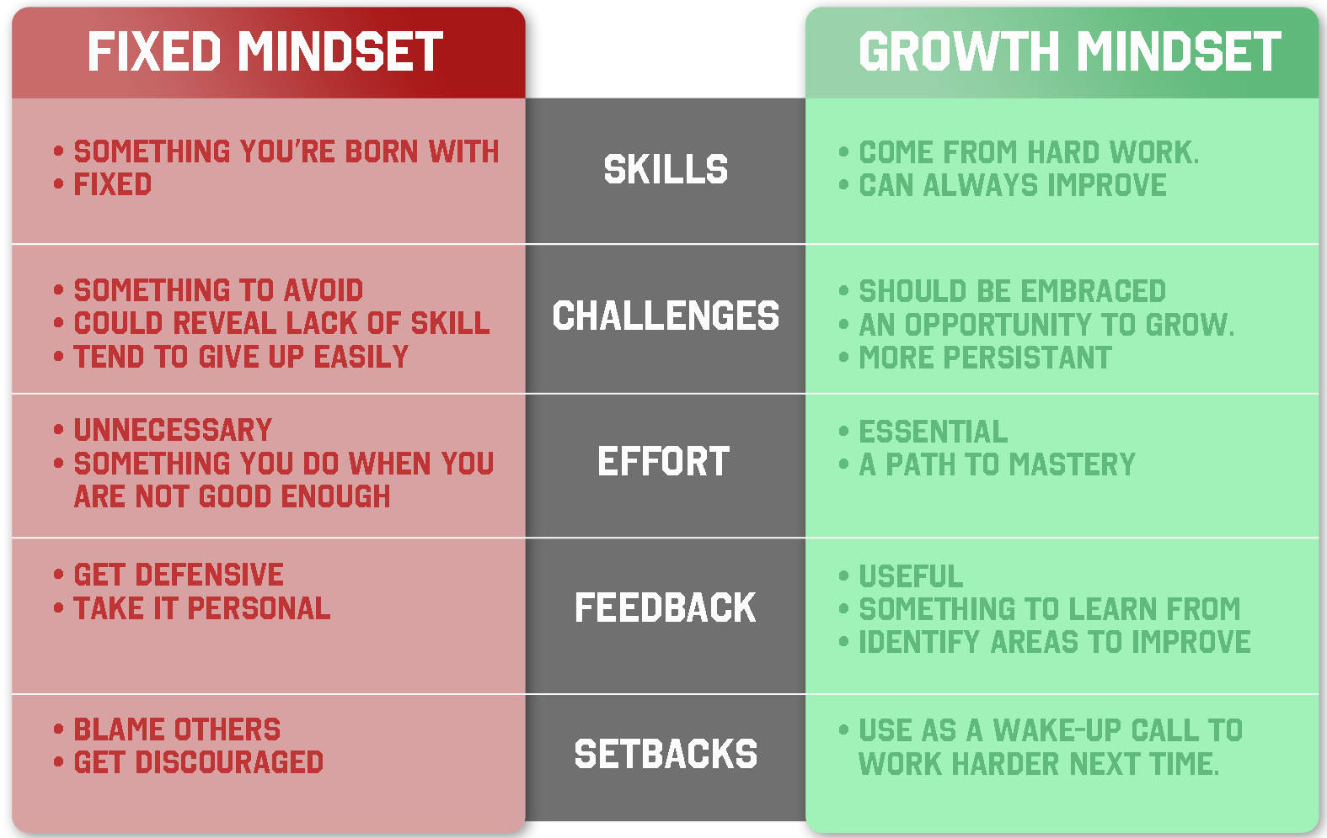
Fixed Mindset vs. Growth Mindset and Neuroplasticity
Image Source: https://www.sparringmind.com/growth-mindset/

Slide 107
Attention Deficit Trait vs. Attention Deficit Disorder
Attention Deficit Trait (ADT)
  Primarily caused by distracting environment
  Also caused by lack of boundaries, poor nutrition & executive function skills (more of a growth mindset definition)
  Most organizations serving the poor and addicted are extremely distracting environments by their nature
Attention Deficit Disorder (ADD/ADHD)
  Primarily caused by a person’s biology (fixed mindset definition)
Many of our students either have ADD or are in a distracting environment (ADT)

Slide 108
ADT/ADD Implications for Study Environment
Students should strive to have extremely strong boundaries for their study environment
  Have fixed hours. Commit to 17 hours a week per course.
  Treat study hours like a job and avoid all distractions. Ask family members and others to respect that time as if you are at work
  No music with lyrics or background TV
  Close web browsers on any non-school related websites (social media)
  Keep mobile phone out of room if it’s a distraction
  Close email and remove any notifications on your computer
  Use a desk if possible and clear it from any distractions
Study hard/rest hard
  Manage energy by taking restful breaks (walking, exercise, prayer, worship,
  not websites, TV, video games, social media)
  Do rewarding things after studying, not before (dopamine detox)

Slide 109

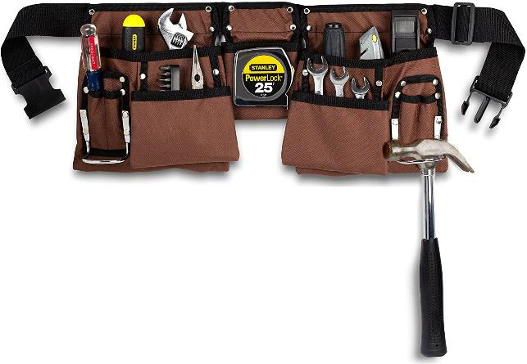

Hammers, Toolkits & The Wise Engineer
Stage 1.
Same Tool for Everything
Stage 2.
Extensive Toolkit
Stage 3. Extensive Toolkit & Use
the Right Tool in the Right Context
This Course is a Survey of Tools
Most other courses will teach
mastery of single tools
Goal of Degree Program
Source: https://www.tyrell.co/2019/05/the-old-engineer-and-hammer.html, https://www.pinterest.com/pin/215821007131374920/, https://www.amazon.com/Pocket-Construction-Adjustable-Release-Buckle/dp/B07FD2H4N2
Notes:
A giant engine in a factory failed. The factory owners had spoken to several ‘experts’ but none of them could show the owners how they could solve the problem.
Eventually the owners brought in an old man who had been fixing engines for many years.
After inspecting the huge engine for a minute or two, the old man pulled a hammer out of his tool bag and gently tapped on the engine. Immediately the engine sprung back into life.
A week later, the owners of the business received an invoice from the old man for $1,000. Flabbergasted, they wrote to the old man asking him to send through an itemized bill.
The man replied with a bill that said:
Use of a hammer: $1.00
Knowing where to tap: $999.00

Slide 110
Components of a Bachelor’s Degree Plan
Complete Major Core Courses
Complete Concentration Courses (if major has concentration)
General Education
  Minimum 30 credits total
  Broad Knowledge and Intellectual Skills (minimum 3 courses)
  Communications (minimum 1 course)
  Christian Life and Thought (minimum 1 course)
120 Total Credits (with at least a 2.0 GPA)
Notes:
Visit sample degree page

Slide 111
Addiction Counseling Courses
Core Courses (7 minimum)
Introduction to Christian Addiction Counseling
Addiction Counseling Certification Preparation
Recovery Coaching & Peer Support Specialist
Professional Counseling Practices
Drugs of Abuse
Counseling Foundations
Spirituality & Addiction
Case Management
Counseling in Urban & Multicultural Environments
Core Electives (3 minimum)
Technology, Life Balance & Behavioral Addictions
Family Issues & Recovery
Sexual Issues in Addiction
Group Counseling Practices
Mental Illness, Addiction & Dual Diagnosis
Counseling Alcoholics
Chaplaincy
Vocation, Calling & Purpose of Work
Nonprofit Educational Program Design
Managing Residential Recovery Programs

Slide 112
Eight Practice Domains of Addiction Counseling

Slide 113
What Makes City Vision’s Addiction Counseling Program Unique
Christian Integration & Summary Courses
1. Clinical Evaluation
2.Treatment Planning
3. Referral
4. Service Coordination
5.
Counseling
6. Client, Family & Community Education
7. Documentation
8. Professional & Ethical
Responsibilities
Integration into
Christian Worldview
City Vision Values
Jesus: Christian worldview
Justice: wholistic approach
Technology: online education
Wholistic Approach
Means You Need
More Education In
Related Disciplines

Slide 114
Understanding the Purpose of General Education
“For now we see through a glass, darkly;
but then face to face: now I know in part;
but then shall I know even as also I am known.”
1 Corinthians 13:12
Most people are single discipline, while
most problems are interdisciplinary
Image Source: https://www.pinterest.com/pin/215821007131374920/
Notes:
Glasses vs. Tools.

Slide 115
A Systems Perspective: Interdisciplinary Problem Solving with all Four Quadrants
Q1 Personal: Nurture (Humanities)
(Relational: the I)
Q2: Physical: Nature (Science & Technology)
(Physical need: it)
Humanities
Western Theology
Counseling
Psychology
Art for Self
Biology
Chemistry
Physics
Engineering
Medicine
Healthcare/Life Sciences
Individual
Q3: Cultural
(Cultural & Social needs: we)
Q4: Societal (Social Sciences)
(Systems: they)
Worship/Music
Most Non-Western theology
Gender studies
Cultural studies
Anthropology
Ethics
Art for others
Micro
Organizational & Business Management
Microeconomics
Macro
Sociology
Law, Political Science
Economics
History
Ecology
Collective
Internal (subjective)
External (objective)

Slide 116
T-Shaped: Major and General Education
Broad General Education
Deep Education in Your Major

Slide 117
A Christian Systems Approach to Understanding Causes of Addiction (Assessment)
Q1 Personal: Nurture (Humanities)
Q2: Physical: Nature (Science & Technology)
Unemployment
Lack of emotional intelligence
Personal isolation/broken relationships
Spiritual emptiness
Wounds from abuse
Separation from God
Biochemistry of addiction
Medical Treatments
Hereditary predisposition
Easy access to drugs/addiction
Lack of physical care of bodies
Biophysical emotional predisposition
Individual
Q3: Cultural
Q4: Societal (Social Sciences)
Cultural devaluation of emotion,
spiritual, relationships, etc.
Subcultures where addiction is norm
Drugs, alcohol, sex, food & materialism
promoted in mass media
Current cultural oppression (racism, etc.)
Cultural inheritance from past oppression
“Worship” of sex, hedonism and other
“gods” permeates culture
Breakdown of family
Lack of jobs
Systemic Oppression (Racism, etc.)
Political priorities
Economics of drug trade
Global exploitation
Failed States/Governments
Globalization of crime
Collective
Internal
External
Notes:
Applying systemic theology to a current problem like addiction helps explain how systemic theology can be helpful.
Most problems like addiction have multiple inter-related causes.
Using the four quadrants and the different fields in each quadrant helps to understand different potential causes.
We often try to simplify things into one cause, and we have big debates over which item is the only cause.
These debates often can be summarized as “I believe Quadrant x is the most important (because of my predisposition) vs. I believe Quadrant y is the most important (based on my predisposition).”
If we understand multifaceted systemic causes, we can come up with a multifaceted solution.

Slide 118
A Christian Systems Approach to Understanding Causes of Addiction (Treatment) Plan)
Q1 Personal: Nurture (Humanities)
Q2: Physical: Nature (Science & Technology)
Get a job
Go to Counseling
Get healthy friendships
Form identity
Establish physical & emotional safety
Pursue spiritual fulfillment
Get healing from wounds of abuse
Get connected to God
Assistance with physical needs
Get on proper psychotropic medication
Remove access to addictive item
Avoid HALT (Hungry, Angry, Lonely, Tired)
Individual
Q3: Cultural
Q4: Societal (Social Sciences)
Spiritual revival
Pursue or create subcultures that value
emotion, spiritual, relationships, etc.
Avoid subcultures where addiction is norm
Avoid triggering mass media
Pursue groups that help to cope with
cultural oppression
Pursue groups that positively address
cultural inheritance from past oppression
Immerse in culture that worships God
Micro (development)
Community development organizations
Micro-economic development
Macro (advocacy & structural change)
Just laws & policies
Healthy social structures
Just teaching of history (Black history, etc.)
Macro-economic development
Collective
Internal
External
Notes:
Applying systemic theology to a current problem like addiction helps explain how systemic theology can be helpful.
Most problems like addiction have multiple inter-related causes.
Using the four quadrants and the different fields in each quadrant helps to understand different potential causes.
We often try to simplify things into one cause, and we have big debates over which item is the only cause.
These debates often can be summarized as “I believe Quadrant x is the most important (because of my predisposition) vs. I believe Quadrant y is the most important (based on my predisposition).”
If we understand multifaceted systemic causes, we can come up with a multifaceted solution.

Slide 119
City Vision’s General Education Courses
Broad Knowledge and Intellectual Skills
(minimum 3 courses Bachelor’s, 2 courses Associate’s)
BUS407: Cross-Cultural Management & Ministry
BUS409: Leadership in Diverse and Under-Resourced Communities (MBA Undergrad Section)
CVC106: Prior Learning Assessment Portfolio Development
CVC306: Managing Residential Recovery Programs
CVC401: Counseling in Urban & Multicultural Environments
CVC402: Nonprofit Educational Program Design
CVC404: Case Management
CVC407: Chaplaincy
CVC411: Spirituality & Addiction
CVC412: Counseling Foundations
CVC413: Drugs of Abuse
CVC414: Counseling Alcoholics
CVC415: Professional Counseling Practices
CVC416: Mental Illness, Addiction & Dual Diagnosis
CVC417: Group Counseling Practices
CVC418: Sexual Issues in Addiction
CVC419: Family Issues & Recovery
CVC432: Technology, Life Balance & Behavioral Addictions
Communications (minimum one course)
BUS105: Business Communications
ENG101: English Composition I
Christian Life and Thought (minimum one course)
CVC330: Urban Youth Ministry
CVC331: Christian Community Development
CVC340: Old Testament Survey
CVC341: New Testament Survey
CVC403: Urban Evangelism & Discipleship
CVC406: Vocation, Calling & Purpose of Work (take early in program)
CVC408: Bible Interpretation
CVC409: Biblical Theology
CVC411: Spirituality & Addiction
CVC419: Family Issues & Recovery
Courses can count either toward a major requirement or general education, but not both

Slide 120
Courses to Take to Help Your Degree Success
If long writing assignments are a challenge:
  English Composition
  Business Communication
If distraction is a challenge:
  Technology, Life Balance & Behavioral Addictions

Slide 121
If You Need to Change Your Degree
Email support@cityvision.edu

Slide 122

Notes:
Explain how to fill in degree plan
If you are not an Addiction Counseling major and you are taking this course as an elective, then do the career planning assignments based on your own major and career plan.

Slide 123
Note for Non-Addiction Counseling Majors
If you are not an Addiction Counseling major and you are taking this course as an elective, then do the career planning assignments based on your own major and career plan.

Slide 124
Addiction Counseling Licensing and Certification
Dr. Andrew Sears
President
City Vision University
www.cityvision.edu
Introduction to Christian Addiction Counseling
Free Course at www.cityvisioninstitute.org

Slide 125
Addiction Counseling Organizations & Certifications
NAADAC (National Association for Alcoholism & Drug Abuse Counselors)
  US-focused
  National Certified Peer Recovery Support Specialist (NCPRSS)
  National Certified Addiction Counselor Level I (NCAC I)
  National Certified Addiction Counselor Level II (NCAC II)
  Nicotine Dependence Specialist (NDS)
  National Certified Adolescent Addictions Counselor (NCAAC)
  Master Addiction Counselor (MAC)
IC&RC (International Certification & Reciprocity Consortium)
  Internationally recognized, but also used by many US states
  Peer Recovery (PR)
  Prevention Specialist (PS)
  Certified Criminal Justice Addictions Professional (CCJP)
  Alcohol and Drug Counselor
  Advanced Alcohol & Drug Counselor (AADC)
  Clinical Supervisor (CS)

Slide 126
Certificate vs. Certification vs. Licensing
Certificate
  Typically provided by a university for a collection of courses (less than a degree)
  Certificates not offered by an accredited university are just a piece of paper
Certification
  Sometimes certifications are offered by an association (be sure they are industry recognized)
  Some states use the word “certification” to be synonymous with “licensing”
Licensing
  State authorizes an individual to be an addiction counselor
  Often tied with insurance and receiving Medicaid
  Often required to become a state certified/licensed center

Slide 127
Addiction Counseling Licensing
States will have licensing model from NAADAC and/or IC&RC standards
Most states will require some combination of:
  Education Hours (City Vision courses typically count toward). Some states may have components that require local in-person training.
  Exam (City Vision courses are aligned to help you pass)
  Supervised Practicum Hours (can receive through practicum course)
  Work Experience Hours

Slide 128
Example Missouri CDAC & NAADAC NCAC
Missouri License NAADAC Certification
Certified Alcohol & Drug Counselor National Certified Addiction Counselor I
Education Hours 180 (local in MO) 270
Practicum Hours 300 None
Experience Hours BS: 2,000, AS: 3,000, HS: 4,000 6,000
Exam IC&RC ADC Exam IC&RC ADC Exam or NCAC Level 1
Other Active State License

Slide 129
Other forms of Counseling Licensure
Clinical Social Worker (LCSW, CSWE Accreditation)
  Masters: Cost the most but is consider the gold standard
Licensed Professional Counselor (LPC, CACREP accreditation)
  Masters: Significant cost (silver standard)
Licensed Marriage and Family Therapist (MFT, AAMFT accreditation)
Clinical Pastoral Education (CPE, ACPE accreditation)
Board Certified Chaplain
Advantage
  Many more jobs and much higher pay
Disadvantage
  Most require a Master’s Degree that are often long, costly and indoctrinate in a secular framework

Slide 130
Non-Licensed Certifications
Pastoral
  American Association of Pastoral Counselors
  National Board for Certified Pastoral Counselors
Biblical Counseling
  ACBC
  CCEF
Life Coach

Slide 131
Professional Development Paths in Addiction Counseling
Most Go Direct
Peer Support Specialist Course
Certified Peer Recovery or Prevention Specialist
(typically 6 months to one year)
Addiction Counseling
Certification Prep
Most Addiction Counseling Courses
Licensed Addiction Counselor
(multiple years for CAC 1, Alcohol & Drug Counselor more for CAC 2)
Master Addiction Counselor (MAC)
Master’s in Clinical Social Work (LCSW)
Master’s in Clinical Counseling (LPC)

Slide 132
Eight Practice Domains of Addiction Counseling

Slide 133
Christian Integration Across 8 Core Functions
Integration into
Christian Worldview
Christian Integration & Summary Courses
1. Clinical Evaluation
2.Treatment Planning
3. Referral
4. Service Coordination
5.
Counseling
6. Client, Family & Community Education
7. Documentation
8. Professional & Ethical
Responsibilities

Slide 134
8 Practice Domains and 12 Core Functions
Eight Practice Domains | Twelve Core Functions
1. Clinical Evaluation | Screening Intake Orientation Assessment
2. Treatment Planning | 5. Treatment Planning
3. Referral | 10. Referral
4. Service Coordination | 7. Case Management
5. Counseling | 6. Counseling 8. Crisis Intervention
6. Client, Family, and Community Education | 9. Client Education
7. Documentation | 11. Reports and Record Keeping
8. Professional and Ethical Responsibilities | 12. Consultation with other Professionals

Slide 135
City Vision Addiction Counseling Courses
Core Courses (7 minimum)
Introduction to Christian Addiction Counseling
Addiction Counseling Certification Preparation
Recovery Coaching & Peer Support Specialist
Professional Counseling Practices
Drugs of Abuse
Counseling Foundations
Spirituality & Addiction
Case Management
Counseling in Urban & Multicultural Environments
Core Electives (3 minimum)
Technology, Life Balance & Behavioral Addictions
Family Issues & Recovery
Sexual Issues in Addiction
Group Counseling Practices
Mental Illness, Addiction & Dual Diagnosis
Counseling Alcoholics
Chaplaincy
Vocation, Calling & Purpose of Work
Nonprofit Educational program Design
Managing Residential Recovery Programs

Slide 136
History and Vision of City Vision University
Dr. Andrew Sears
President
City Vision University
www.cityvision.edu

Slide 137
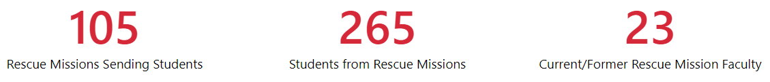
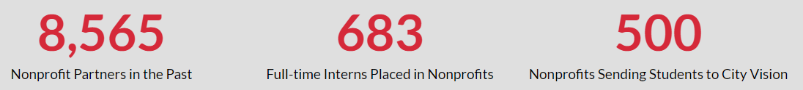



City Vision History, Recognition & Awards
History with
Rescue Missions
History with
Christian Nonprofits
National
Recognition
Personal
History

Slide 138
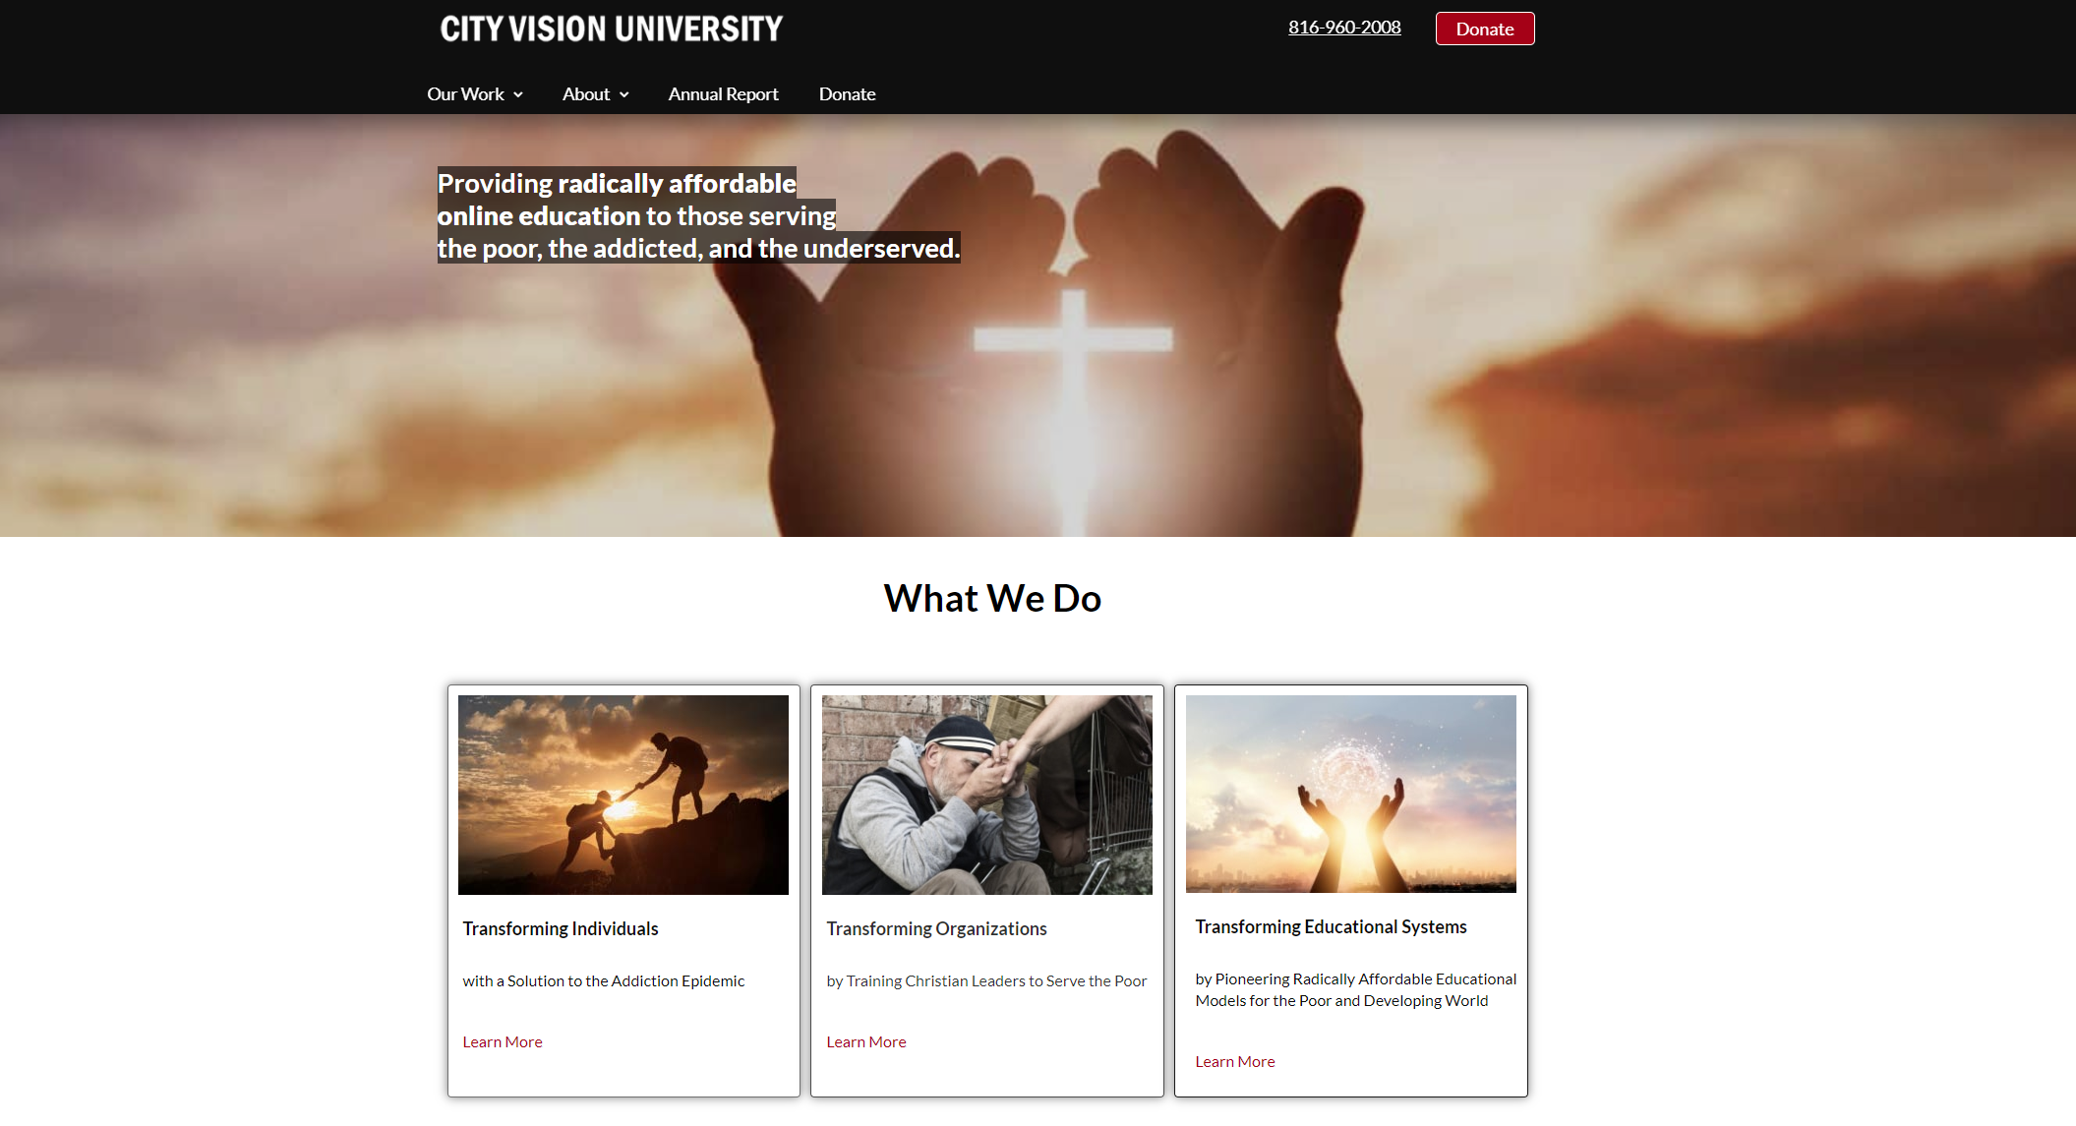

Slide 139
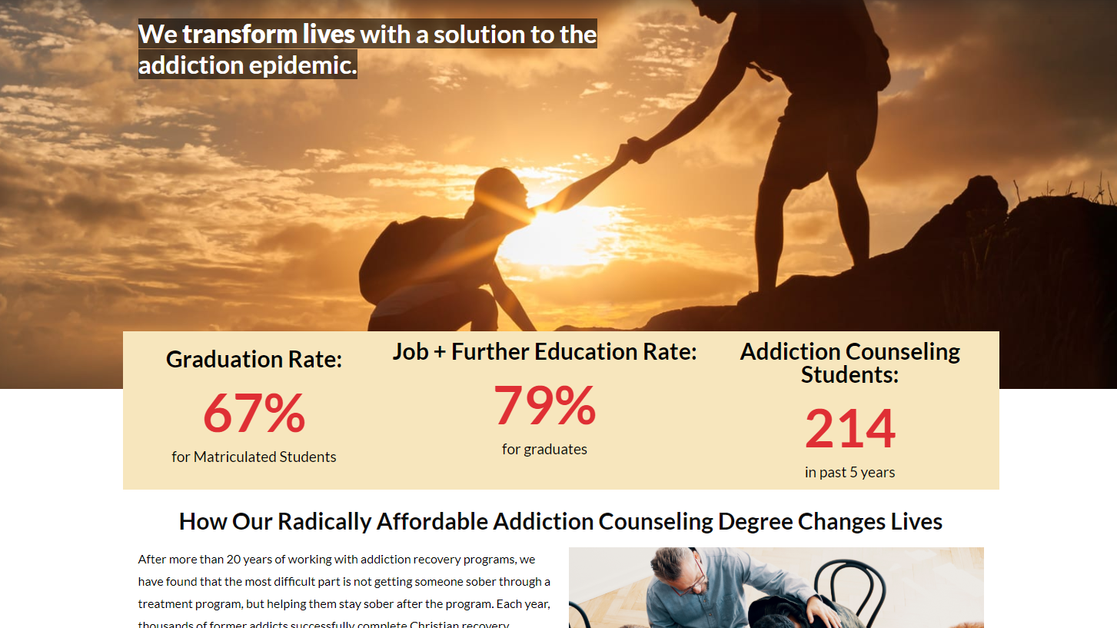

Slide 140
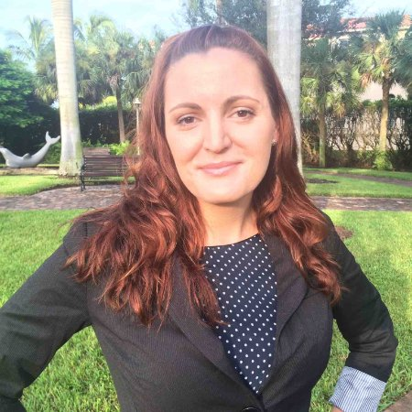
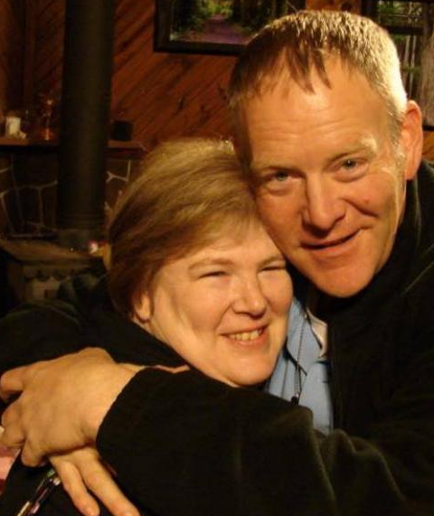
Transforming Individuals Stories
“City Vision is not only a school, but also a ministry.”
– Brittany Hargrove
“City Vision provided a Biblical understanding of addiction that helped transform my life.”
– Jon Dean
Notes:
Brittany Hargrove was introduced to drugs by hanging out with the wrong crowd in college. After she became addicted, she dropped out of college. When she was arrested, she was facing a prison sentence.
She turned back to Jesus, and entered a recovery program at St. Matthew’s House in Naples, FL where she was discipled and got free from her addiction. She completed her Bachelor’s in Addiction Studies through City Vision, and now counsels former addicts through St. Matthew’s House. She is happily married. Now she is enrolled in City Vision’s MBA program, and is on the way to bearing hundredfold fruit.
Jon Dean was an addict for 22 years and a gang member for 27 years after starting drugs at age 13. He had a profound encounter with God that ultimately led him to decide to follow Jesus at the Hiway 80 Rescue Mission. He continued his recovery and discipleship through the House of Disciples in Longview, Texas and as a student in City Vision University’s Addiction Counseling program. Jon graduated with a bachelor’s degree and is now a case manager with the House of Disciples, where he works with recovering addicts and ex-offenders to help them experience the transformation that he did.

Slide 141
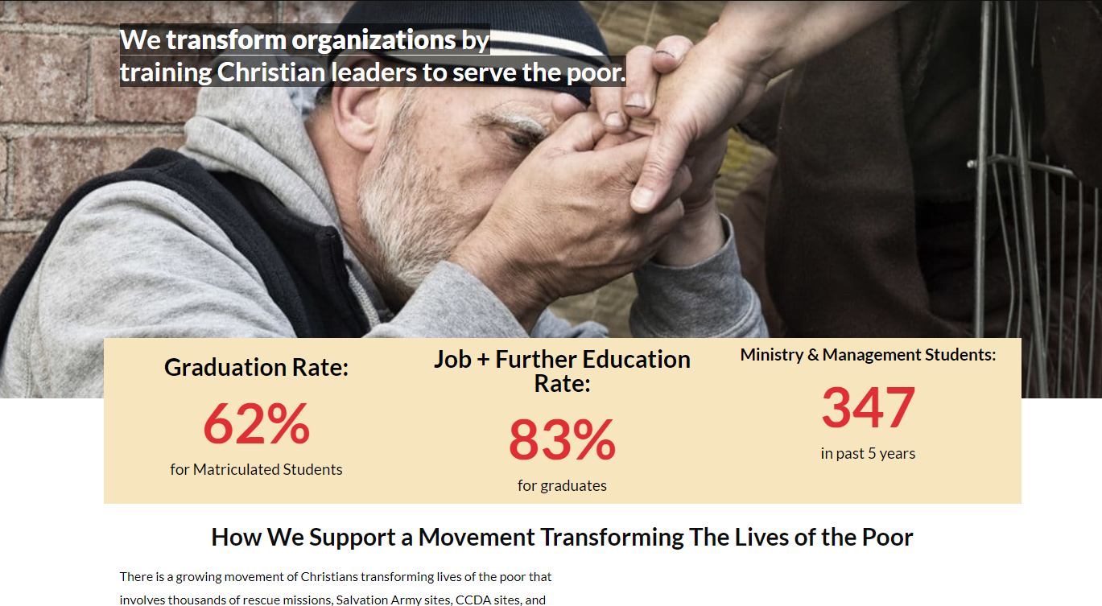

Slide 142


Transforming Organizations Stories
142
01
33+ Students with City Vision
Provided two faculty members
"The partnership with City Vision has been one of the most important factors to equip our team to minister to the needs of the poor. Without this partnership, we wouldn’t be nearly as effective serving our most vulnerable neighbors.“
- Vann Ellison, Executive Director, St. Matthew’s House
02
Co-developed joint program for 18 staff and interns across 5 countries
Paid City Vision to develop custom open courses on City Vision Institute
Engineering Ministries
International
03
City Vision Student, Michelle Porter
Founded 2 rescue missions
20+ Student & Interns

Slide 143

Transforming
Organizations
Transforming
Individuals
Addressing
COVID Crisis
Transforming
Christian
Education

Slide 144
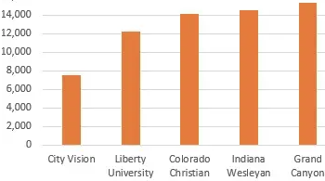
What Makes City Vision Unique?
Extremely targeted practical education for Christians serving the poor, addicted and underserved
  Much more relevant than generic Christian ministry, business, nonprofit or counseling degrees
Affordability & Convenience
  Cost less than half of most other online Christian degrees
  Prior learning credit for up to 25% of degree + credit partners
  Convenience of online education
Deep Christian integration
  We help translate tools into a Christian context
Business model focused around Christian nonprofit partnerships
  We help you drive growth in your organization

Slide 145
What We Do: Relationship Between Programs
MBA
Program
(5)
CityVisionInstitute.org
15,000+ in free Courses
1. Can Develop Customized “Corporate Training”
20 staff & 30 participants
from your organization
2. Free Courses
Help Recruit
Paying Students
In Accredited
Courses
Addiction Counseling
Program
Ministry & Management
Programs
Nonprofit Management
Ministry
Business
MBA & MSOL
Example: 5 students
from your organization

Slide 146

Management and Ministry Faculty

Slide 147

Addiction Counseling Faculty

Slide 148
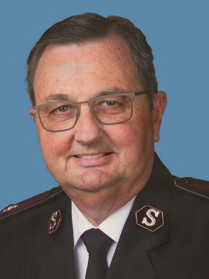

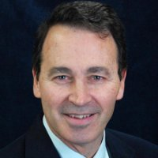


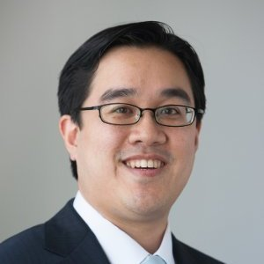
City Vision Board
Commissioner Jim Knaggs
Former Territory Commander
Salvation Army Western Territory
Harriet Hodge Henry
Pastor, The Gathering
Dr. Jay Gary
Director of Online Programs
Oral Roberts University
Dr. Brad Smith
President
Bakke University
Dr. Walker Tzeng, COO
Olivet University
WEA, ABHE
Dr. Amanda Forbes
Executive Director
Trinity Education Global

Slide 149
How You Can Help in this Vision
Train others in what you learned at City Vision
Share our free courses with others in your organization
Refer other students to City Vision
Set up calls between your organization’s leadership and City Vision
  Help in the Transforming Organizations vision
  We can help your organization set up an educational employee benefits program
  See Partners menu on www.cityvision.edu
  Send email to Andrew@cityvision.edu if interested
Stay connected and support City Vision after graduation
  Consider giving either individually or through your church or organization
  Scholarships only work if alumni and other donors continue to give

Slide 150
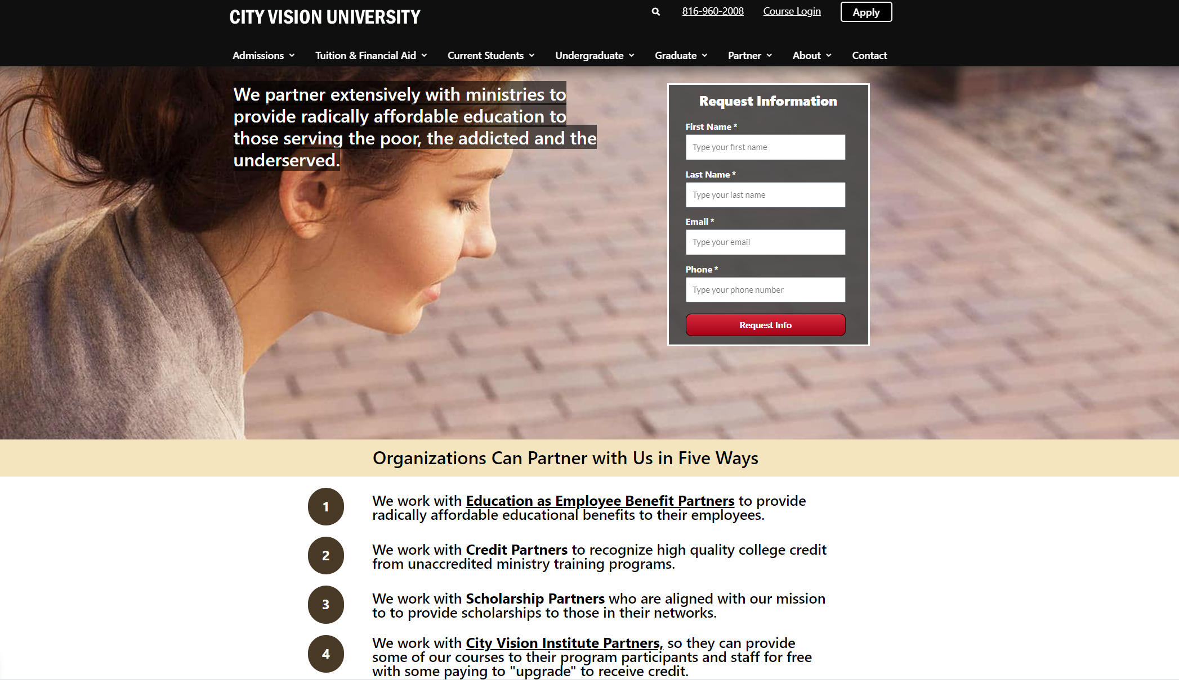

Slide 151
Finding a Practicum Site or Supervision Site in Addiction Counseling
Dr. Andrew Sears
President
City Vision University
www.cityvision.edu
Introduction to Christian Addiction Counseling
Free Course at www.cityvisioninstitute.org

Slide 152
Example Missouri CDAC & NAADAC NCAC
Missouri License NAADAC Certification
Certified Alcohol & Drug Counselor National Certified Addiction Counselor I
Education Hours 180 (local in MO) 270
Practicum Hours 300 None
Experience Hours BS: 2,000, AS: 3,000, HS: 4,000 6,000
Exam IC&RC ADC Exam IC&RC ADC Exam or NCAC Level 1
Other Active State License

Slide 153



Limitations of Online Learning in Addiction Counseling
Head Learning
  Mainly what you can get from courses and books if you never work with organizations on practical assignments
Heart Learning
  Journaling, Reflective Assignments, Faculty Mentoring
  Living and working in addiction counseling (supervision)
  Going through counseling yourself
Hand Learning (doing)
  Living and working in addiction counseling (supervision)
Notes:
My story of undergraduate and graduate learning, nothing practical

Slide 154



Would You Trust Online Learning for…
Managing an Organization
That Transforming Lives
Learning to Ride a Bike?
Flying a Plane?
Simulators
Practical Assignments
in Real Organizations
Practice Flight Time
Internships
Flight Experience
Job in Nonprofit or Ministry

Slide 155
Seeking Supervision Sites for Licensure: Three Groups of Students
Group 1. Not Seeking Licensure
  Do not need to seen out supervision site
Group 2. Seeking Licensure, Currently Staff in Nonprofit or Ministry that can provide counseling supervision
  Need someone who is a licensed counselor that meets your state’s requirements
Group 3. Seeking Licensure, Not Currently Staff or Volunteer Leadership in Nonprofit or Ministry that can provide counseling supervision
  Students who do not develop relationships with nonprofit organizations and get effective practical experience have more difficulty getting jobs

Slide 156
How to Find an Organization
If you are in group 3 or if your organization is small or a church, you will need to find an organization to work with on assignments
Many students do not like “cold calling” organizations, but it is an important professional skill for networking
If this is very difficult for you:
  Talk to us if you have called more than 50 organizations and reached more than 20 organizations and have still been rejected
  While there are advantages to working with a local organization, you could also work with an organization remotely if you cannot find local organizations
  Ultimately your effectiveness is determined by 1) how many organizations you call and 2) how effective you are at “pitching” yourself via phone

Slide 157
How to Identify an Organization for Supervision
Step 1. Getting to the right person
  Do research in advance on their website
  Potential good starting places: Search for job postings, Google Search Addiction Treatment Center
  Call and ask if there is someone on staff who handles counseling interns
  Many students do not like “cold calling” organizations, but it is an important professional skill for networking
Step 2. Interviewing the right person
  and then ask them if they serve as a supervision for Addiction Counseling students needing supervised hours
  Ask them how their process works

Slide 158
City Vision’s 436/514 Internship/Practicum Course
Can only take Internship/Practicum course if:
  You have completed Introduction to Christian Addiction Counseling
  You have room in your degree plan for elective courses
  You have found someone within a nonprofit organization, church or ministry that has signed our supervision agreement
    Could be your current employer if you work for an appropriate organization
    Could serve as an intern volunteering 10 hours a week as a part of your course credit
Basic course structure
  Weekly journaling/reflection on work
  Work log (signed off by supervisor) with about 10 hours a week counting toward course time
  Reading & material relevant to internship
Availability
  436/514 Internship/Practicum Course will be available every term and can be taken a second time (with a different course number)

Slide 159
Licensure Plan and Career Plan Instructions

Slide 160
Lesson 8: Compassion Fatigue, Burnout, Secondary Trauma and Self-Care
Dr. Andrew Sears
President
City Vision University
www.cityvision.edu
Introduction to Christian Addiction Counseling
Free Course at www.cityvisioninstitute.org

Slide 161
Important Concepts to Avoid Burnout
Compassion Fatigue
Emotional Labor
Secondary/Vicarious Trauma
Adrenal Fatigue

Slide 162
Four Quadrant Holistic Plan for Self-Care
Q1 Personal: Nurture (Humanities)
Q2: Physical: Nature (Science & Technology)
Secure a job in a healthy work environment
Go to counseling or life coaching
Develop healthy friendships
Deepen your personality identity
Establish physical & emotional safety
Pursue spiritual fulfillment
Get healing from wounds of abuse
Get connected to God
Avoid behavioral addictions
Eat healthy
Exercise regularly
Monitor symptoms of adrenal fatigue
Treat adrenal fatigue (Integrative/Functional Medicine)
Take healthy vitamins, supplements and medication
under guidance of a doctor
Individual
Q3: Cultural
Q4: Societal (Social Sciences)
Find healthy church & small group that values emotion, spiritual, relationships, etc.
Avoid triggering tech & media use
Participate in health recovery or counseling groups (to receive)
For cultural minorities, find positive groups where you can be in your own culture
Work towards developing more just systems and laws without burning yourself out personally Community development organizations
Collective
Internal
External

